Slide 2
3%. That’s what the government has decided NHS staff in Cymru/Wales deserve
UNISON’s next move on NHS pay is in the hands of our members
We’re consulting until 17 September
You’ve got a powerful voice in UNISON, the largest trade union in the NHS
This presentation will take you through the background to the pay award in Cymru/Wales and the details of our consultation

Slide 3
NHS pay in Cymru/Wales is devolved but…
… the Westminster government’s decisions influence the funding available for NHS pay in Cymru/Wales through the Barnett formula

Slide 4
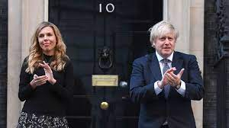
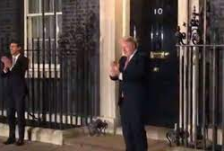
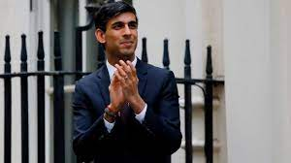
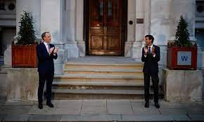
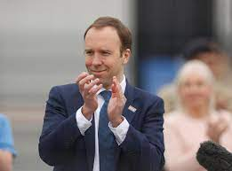
How it started…
Westminster government

Slide 5
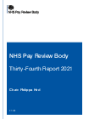
How it ended
Westminster government

Slide 6
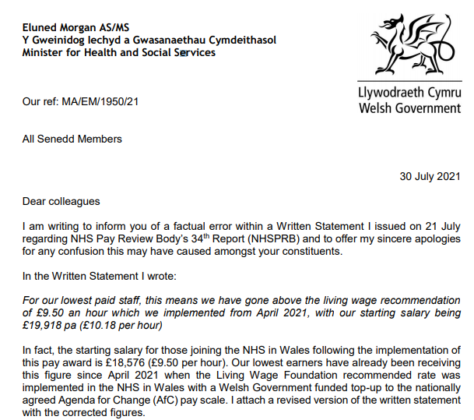
Welsh government
How it ended
Except for lowest pay point

Slide 7
One Team 2k – campaigning all the way
28 August 2020: UNISON submits pay claim for £2k on all pay points – reasonable, fair, values everyone equally, would make a real difference to staff
September 2020 to July 2021:
constant UNISON campaigning for 2k - on line, in the media, in Westminster, in the Senedd and in workplaces including regular #Twodaysfor2k
UNISON provides the NHS Pay Review Body with our written claims for Cymru/Wales, England and Northern Ireland and the PRB holds a discussion session with UNISON’s leading elected health workers

Slide 8
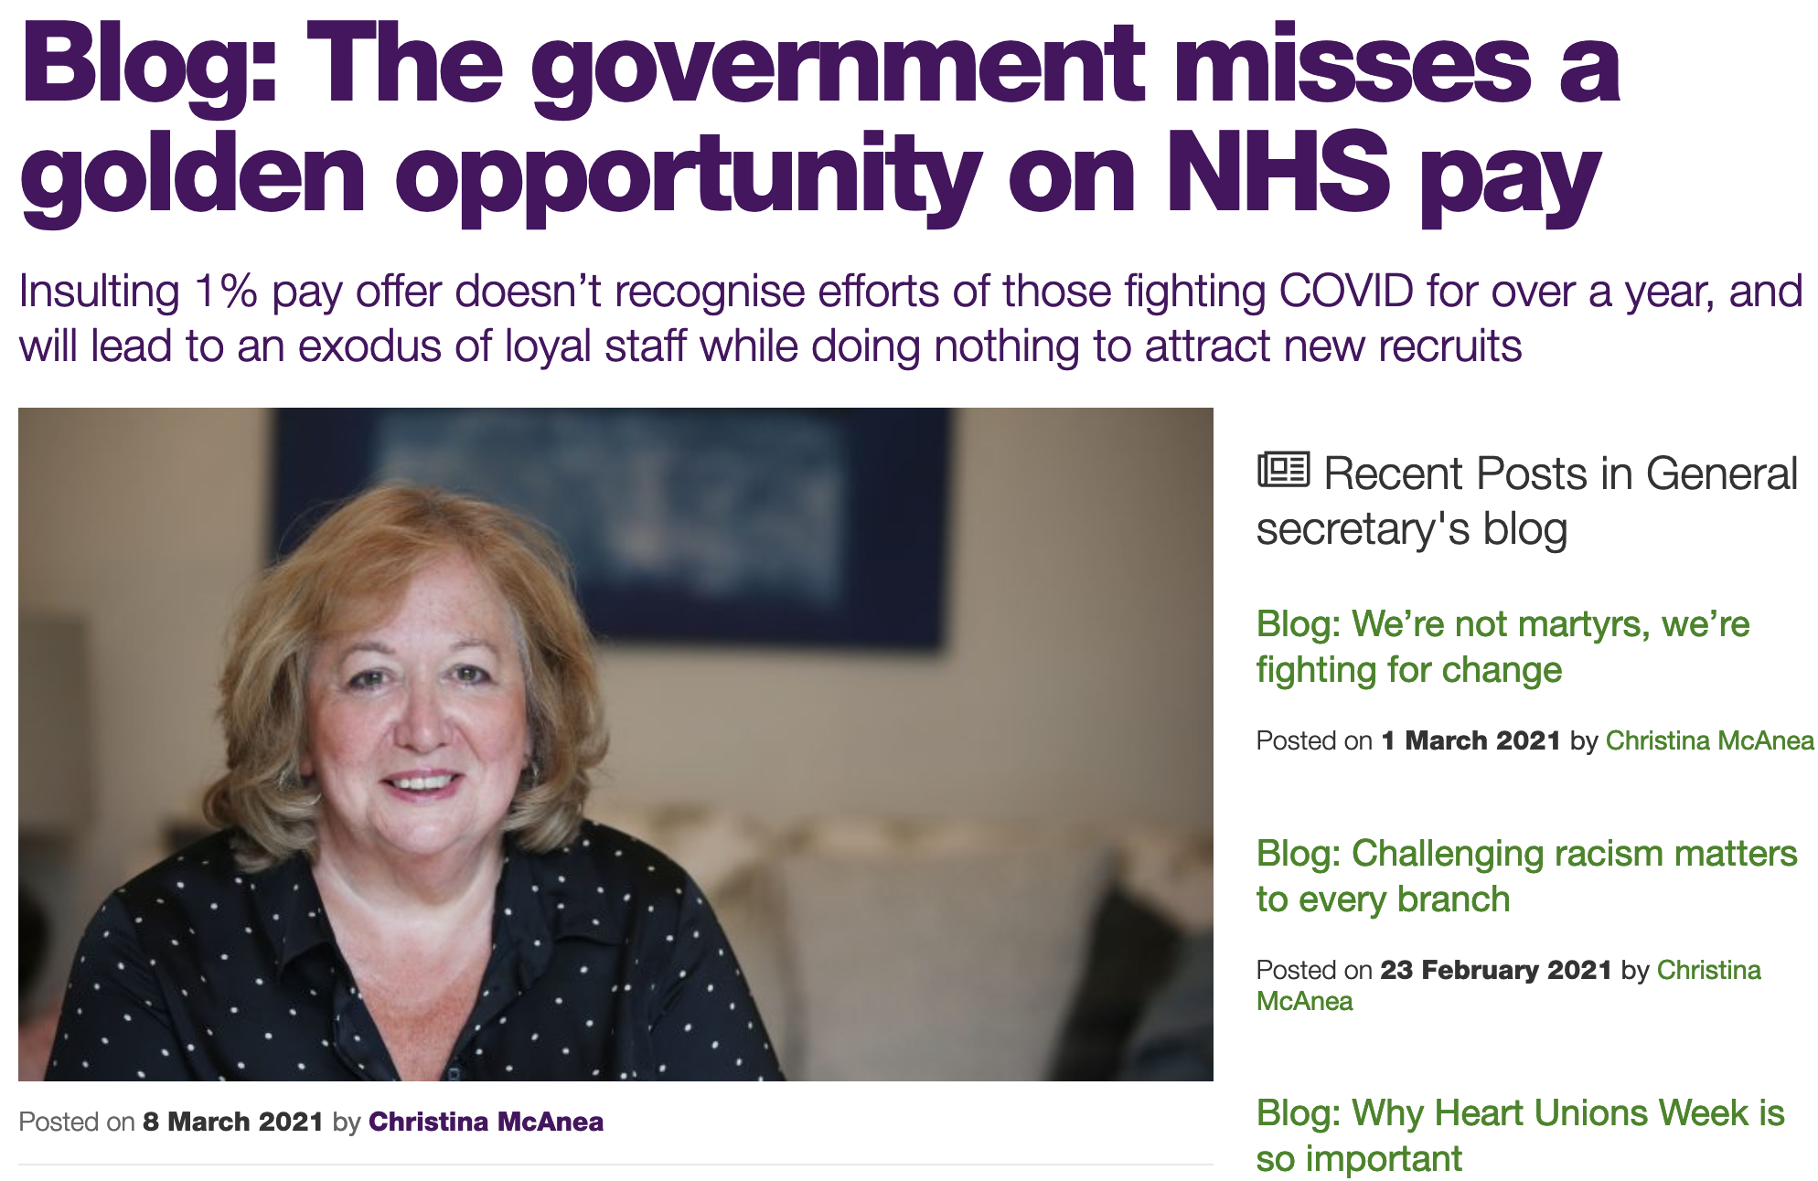
From 1% in March to 3% in July – how we moved the Westminster govt
UNISON leading public reaction in the media, social media
"Our members will be confused, concerned and upset that the government previously appeared to commit to a higher pay award for NHS staff...and is now saying that is not possible."
Danny Mortimer, Chief Executive, NHS Confederation
UNISON lay leaders speaking out
Observer-Opinium poll 6 Mar 2021
72% think proposed 1% is ‘too low’ including:
-58% of Con voters
-86% of Lab voters
UNISON gathering support from employers, MPs, celebrities, thinktanks…

Slide 9
In summary…
What we asked for
early pay talks
early pay rise of £2k on all AfC pay points
additional funding for £2k AfC rise and to cover rises for contractor staff
What we got
a long-delayed Pay Review Body (PRB) process, not negotiations
A Westminster govt attempt to limit the PRB to 1% - which Welsh govt did not follow
a final decision of 3% for directly employed staff, not an offer
What we’re doing
UNISON’s Cymru/Wales lead committee of NHS workers has assessed the outcome – now we need to know what you want to do next
we’re running a consultative ballot until 17 September so you can have your say

Slide 10
What you need to know
The 3% rise will be back dated to 1 April 2021. It delivers the following cash increases to the tops of bands:
​
[Lowest point £391*]
Top Band 2 £581​
Top Band 3 £635​
Top Band 4 £725​
Top Band 5 £919​
Top Band 6 £1,137​
Top Band 7 £1,336​
Top Band 8a £1,551​
Top Band 8b £1,861
Top Band 8c £2,210​
Top Band 8d £2,633​
Top Band 9 £3,148​
*Band 1 and the entry point to Band 2 are not covered by this 3% award. Instead they were increased by £391 (2.2%) in April in line with the 2020/21 Living Wage Foundation rate

Slide 11
What you need to know
The percentage approach used in the award means that:
the pay rise for the highest paid is over five times as much as the rise for the lowest paid staff
the pay gap between the highest and the lowest paid is stretched wider
the only staff who are getting UNISON’s £2k position are in bands 8c and above
​

Slide 12
What you need to know
UNISON is disappointed Welsh Government decided to impose the 3% pay award in haste and without any consultation with the NHS trade unions.
We have pointed out the more generous deal offered by the Scottish government and again asked for talks about improvements for Cymru/Wales. But, to date, Welsh government is not negotiating with us

Slide 13
UNISON’s position
The pay outcome of 3% fails to meet the demands of our 2k campaign:
It does not increase pay by £2,000 for anyone other than staff in band 8c and above​
It stretches the gap between the highest and the lowest paid staff in the NHS​
It does not include staff on the lowest pay point – they got just a £391 uplift on their annual salary when the government implemented the 2020/21 Living Wage Foundation rate​
Therefore, we cannot recommend members accept this pay outcome.​
To have an impact on the outcome we need to mount widespread and sustained industrial action in the NHS. The bar for this is high, but achievable provided a large majority of UNISON members in the NHS wish to do this.​
If enough members vote for this in the consultation, the next stage would be a formal industrial action ballot.

Slide 14
Your vote: what you will be asked
The government has announced a 3% pay award for staff in the NHS in Cymru/Wales. This outcome is not acceptable and falls far short of our One Team 2k position. We want to hear your views.
This is your choice (tick one):
I accept the outcome and do not wish the union to challenge it
I oppose the outcome and will take part in lawful industrial action up to and including strike action

Slide 15
Your vote: how to use it
You should receive an email with a secure voting link that means you can vote directly (check your junk mail!)
OR
Go to nhspay.org/wales – you will need to verify your membership number or NI number + dob and surname
If your membership details aren’t up-to-date tell your branch or go to www.unison.org.uk/update-your-details
If you’ve just joined or recently updated your details you will be included in the ballot but may not receive communications straight away
If anyone joins and has their membership processed before 8 September they can be included
The closing date for voting is 17 September

Slide 16
Your vote: why it matters
UNISON members have led every stage of the One Team 2k pay campaign – shaping the claim for £2,000, writing to MPs and MSs, signing open letters and spreading the word
Now you all have an important choice. You’re in UNISON, the largest trade union in the NHS. This is your union and you’ve got a powerful voice
We’ve seen before how industrial action, including strikes, can be the key to unlocking improvements but as a member of this union, the decision to move onto that kind of vote is in your hands
Strict laws mean that industrial action can only take place following a lawful postal ballot in which more than 50% of members take part and (in ‘important public services’) more than 40% of those voting are in favour of action
In this consultation we need an accurate test of how NHS staff in UNISON really feel. We can only clearly demonstrate what you want to do next if we hear from every part of the NHS – every role, every workplace, every pay band
So whatever you choose, using your vote is vital. Please take part and encourage your colleagues to do so too

Slide 17
Want more info?
Visit nhspay.org/wales and check out our FAQs
Talk to your UNISON branch
Call UNISON Direct on 0800 0 857 857
Follow us on social media @UNISONWales | www.facebook.com/unisoncymruwales

Slide 18
Want to help spread the word about the consultation?
Talk to your branch about how you can get involved – we always need help putting up posters, handing out leaflets and recruiting new members
Check out our latest resources for activists at www.cymru-wales.unison.org.uk/campaigns/nhs-pay-oneteam2k/
Get social – we have graphics for you to use and share on social media: click here

Slide 19
What happens next?
When the consultation closes Cymru/Wales UNISON’s lead committee of elected NHS workers (the ‘Regional Health Committee’) will:
Meet and consider the results
Make decisions on next steps – based on what the majority of members have told us; and on how many members have taken part
Update branches and members

Slide 20
Thank you for listening…
Now any questions?
And don’t forget to vote!!!
nhspay.org/wales

