Slide 1
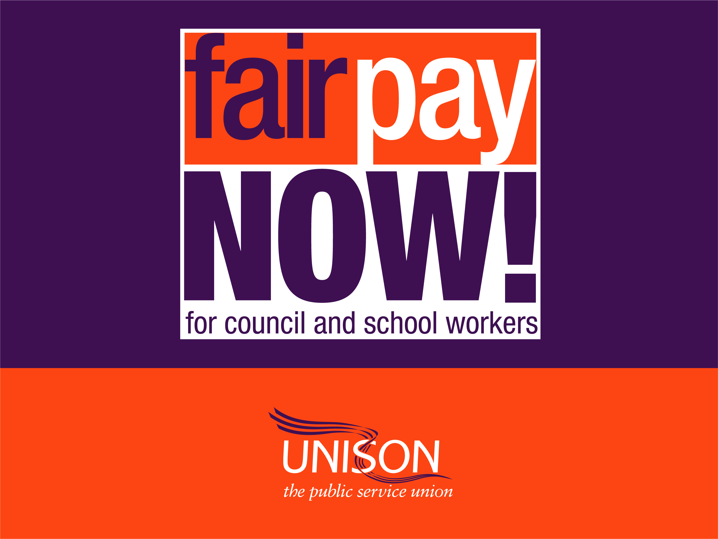

Slide 2
The NJC Pay Claim 2018-19
Deletion of NJC pay points SCP 6-9 to reach the Foundation Living Wage of £8.45 (UK) and £9.74 (London) and …
A 5% increase on all other NJC pay points
The joint pay spine review is running alongside the claim
Notes:
The 2018 claim is set out on this slide. It runs alongside the pay spine review.
It represents the three unions’ aspiration to achieve the Foundation Living wage as the lowest NJC pay point by deleting scp’s 6-9. The 5% increase on all NJC pay points is to reflect inflation and provide some catch up on lost earnings.
If your employer does not use scp’s 6-9, it’s just a straight 5% pay increase on all scp’s – including those within scope of the NJC paid above the maximum of the NJC pay spine.
The UK Foundation Living Wage is an hourly rate of pay set independently and updated annually. It is calculated according to the basic cost of living in the UK. The calculation takes into account things like accommodation, travel, healthy food and birthday presents.
It is not the same as the National Living Wage of £7.50 which is the legal minimum wage for workers aged 25 and over. The National Living Wage doesn’t change in line with increases in the price of food, electricity bills, mortgage payments or rents.

Slide 3
NJC pay explained
The NJC pay spine – pay points from scp 6-49
Used by councils and schools to construct their local pay grades – many variations
UNISON, GMB and Unite submit an annual pay claim to the Local Government Association who represent employers in negotiations
The pay increase is applied to the NJC pay spine
London and a few other councils have their own pay spines – NJC percentage increases are applied
Notes:
The basic pay of each employee consists of a pay point or points on the NJC pay spine – called spinal column points - scp.
The bottom of the NJC spine starts at scp 6 and the top of the spine is scp 49.
Each council or school uses the NJC pay spine to construct their local pay grades . Some employers start their bottom grade on a scp above scp 6 and many extend the NJC spine locally above scp 49.
UNISON, GMB and Unite submit an annual pay claim for a cost of living increase to be implemented in April. We negotiate with the Local Government Association who represent councils.
The pay increase is applied to the NJC pay spine.
London and a few councils do not use the NJC pay spine because they have their own pay spines. The NJC percentage increases are applied to these pay spines.

Slide 4
Context of the claim
Minimum 40% council cuts which are unsustainable
Funding for the claim and pay spine review must come from central government
Implementation of the National Living Wage without extra funding
There is now a significant funding gap in local authorities
Notes:
Funding for this pay rise must come from central government: Councils face unparalleled financial challenges which have resulted from the harsh and unequal austerity measures imposed on local government by Westminster.
Councils cuts are unsustainable: Since 2010 there has been an unprecedented average cut of 40% to councils’ funding and the implementation of the National Living Wage (NLW) without any additional funding from central government - in contrast to the NHS in Wales and Scotland where additional funding was provided to meet the cost of becoming Foundation Living Wage employers. At the same time there will be extra spending responsibilities in relation to help for the growing number of older people with personal care costs and public health.
There is now a significant funding gap in local authorities: Under the LGA’s assumptions, authorities will have to use £3 billion of their reserves in the five years to 2019/20. Similarly research by the New Policy Institute shows that by 2020, current and capital spending combined will be lower than at any time since before 1948.

Slide 5
The impact on our members
Between 2010 – 2016 cost of living (RPI) rose by 22.6%
But most members had an 8 year pay cut – 3 year pay freeze and below inflation increases
For someone earning £20,000, this represents £4,000 in loss of earnings
Prices for everyday goods continue to rise
In these circumstances our claim is relatively modest
Notes:
Between 2010 and 2016 the cost of living as measured by the Retail Prices Index rose by 22.6%.
Yet during this period most of our members effectively had an 8 year pay cut, including a three year pay freeze from 2010 followed by below inflation increases for each year since. The Government has imposed a1% pay cap on the public sector until 2019.
But the local government pay freeze applied for one year more than all other public sector workers and NJC workers did not receive the £250 for those earning less than £21,000 awarded by the then Chancellor George Osborne.
For someone earning just over £20,000 - on the most populated spinal column points (SCP 21) – this represents a cumulative loss of earnings of over £4,000.
In contrast prices for everyday goods continued and continue to rise. Over the year to May 2017 the average price increase was 3.7% but some costs are rising significantly faster – clothing by nearly 10%, electricity at nearly 8%, rail at over 4% and bus fares at 17%.
But current inflation rates mask longer term changes in the cost of living that’s taken place since 2010. For food it is 11%, electricity 28%, rail 24% and bus fares 26%.
In the circumstances our claim is relatively modest in providing some catch up on lost earnings.

Slide 6
Notes:
And inflation is rising fast.
Inflation is predicted to remain in excess of 3% for the next five years. This means that the cost of living for our members will rise by nearly 18% by 2021. In that context, a 1% pay offer for the sector would be unacceptable.
If the 1% pay cap continues through to 2019 as proposed, the average NJC wage will have declined in value by a further £1,100.

Slide 7
Average earnings and settlements
Forecasts of average earnings growth this year –
2.6%, rising to 3.6% by 2021
Average pay settlements across the economy
Sector | Average pay settlement
Energy & gas | 1.6%
Water & waste management | 1.7%
Retail & wholesale | 2.4%
Information & communication | 2.0%
Admin & support services | 2.0%
Notes:
This table shows average current pay settlements across a range of sectors.
These sectors are in direct competition for workers in jobs within the school and local government sectors.
Pay settlements in the private sector stand at 2% which is double that in the public and not for profit sectors.
Private sector settlements have been running far in advance of NJC pay since 2010. When NJC pay was frozen for 3 years average private sector pay rises were 2.1%.

Slide 8
Pay at the bottom pegged to NMW or NLW
Notes:
Local government has the strongest case for a decent pay rise following years of neglect as this graph shows.
The graph shows the decline in the value of the bottom rate of NJC pay compared to the legal minimum rate of pay for the rest of the economy since 1999.
In 1999 there was a 24% difference. By 2016 it had reduced to a shocking 0.3% difference.
The legal minimum wage floor for the whole economy has essentially become a benchmark for our pay despite the highly responsible and skilled nature of your jobs.
We became used to being the poor relations of the public sector in the last two decades and are now the confirmed poor relations of the UK economy.
NJC workers on the bottom pay point will require a 15.7% increase in pay to reach the currently projected rate for the National Living Wage of £9 per hour by 2020.

Slide 9
Low pay throughout the pay spine
NJC and NHS pay compared
NHS Job title | NJC job title | NJC salary | NHS 37 Hour | Difference (£) | Difference (%)
Domestic Support Worker | Cleaner | £14,311 | £15,047 min. or £15,309 max | £736 - £998 | 5.1% – 7%
Nursery Nurse | Nursery Worker | £18,379 | £20,771 | £2,392 | 13%
Librarian (1/4/16) | Librarian (1/4/16) | £23,166 | £24,960 | £1,794 | 7.7%
Health Improvement Principal | Principal Environmental Health Officer | £38,171 | £50,529 | £12,358 | 32.4%
Notes:
This table shows the difference between pay levels in equivalent jobs across the NJC and NHS pay structures
Whilst we have seen pay rises above 1% at the bottom of the pay spine to ensure employers keep above the legal pay minimum, everyone else in the pay structure has received 1%.
Pay for all working in local government and schools is lower than for anyone else working in the public sector where pay was only frozen for two years and those earning less than £21k got £250
It is not just pay for the lower graded jobs that is unequal in the public sector. At the top NHS, other public sector and local government jobs are very similar, but pay is very different.
The top of the NJC pay spine stands at just over £43,000. This compares to nearly £100, 000 within the NHS and nearly £65,000 in Higher Education.

Slide 10
But it’s not just about pay...
Terms and conditions slashed
Job losses
Reviews, reorganisations and
redundancies.
Work pressure and stress
Recruitment and retention problems
Notes:
But it’s not just about cost of living pay – other conditions have also been slashed. Most councils are slashing conditions of work such as unsocial hours payments and car allowances – alongside the decline in basic pay.
This means workers providing services that require them to work regular overtime, shift work and unsocial hours work, are suffering further reductions in pay as additional payments are cut.
Since June 2010, local government has lost over 760,000 jobs.
Those workers left behind face increased workloads, reorganisations, pressure and stress – on top of shrinking pay packets. As a result, local services, and those reliant upon them, suffer.
With pay comparing so badly with the rest of the public and private sectors, 71% of councils unsurprisingly report recruitment and retention problems (LGA figures) This has led to a marked increase in the use of expensive agency workers to plug the gaps - an increase from 8% to 13%

Slide 11
We want local government to:
Value and appreciate you for the crucial job you do
Reward and respect your loyalty
Pay you well and give you conditions of work
…in line with the rest of the public sector
Give you access to training and career development
Provides prospects for promotion
And a decent pension for retirement
Notes:
We want local government to:
Value and appreciate you
Pay you well for the important job you do
Reward and respect your loyalty
Provide prospects for promotion
And decent pension for retirement
We want local services delivered by a well paid, well rewarded and motivated workforce, with career prospects.
Our members tell us that this is the most important way to provide better services.
Services and jobs to be proud of – not services held together by goodwill and poverty pay.

Slide 12
Join our campaign for fair pay now
The Government’s 1% pay cap is unjust and unsustainable
Local government cuts are destructive to services and staff
Political and public opinion is turning against austerity
Sign up for updates, be part of our campaign
Together we are stronger – your voice is louder
Talk to friends and workmates
UNISON is standing up for the job you do
Notes:
So join our campaign for fair pay now. We are campaigning for an end to the public sector pay cap in local government and for government recognition that NJC workers have a unique case for a decent pay award
Recognition that there are major benefits to the economy that would arise from lifting the government’s 1% public sector pay cap and easing the squeeze on living standards.
Austerity has become unpopular with all political parties – due to the general election results and uncertainly around the economy because of Brexit.
The latest British social attitudes survey indicates public tolerance of austerity is collapsing. The survey found popular support for higher taxes and increased public spending is stronger than it has been for more than a decade
So sign up for updates and be part of our campaign
Together we are stronger and your voice is louder. Pressure can change government policy.
Talk to friends, colleagues and workmates and let them know that UNISON will stand up for the job you do.

Slide 13
Immediate action
The LGA is consulting councils on our claim over the summer
We anticipate a pay offer in late September
Our claim and the pay spine review require funding beyond the 1% government pay cap
We are lobbying national and local politicians hard to make the case for extra funding
Send our model letter and motion to your councillors
Notes:
The Local Government Association is consulting councils on our claim in July and August. They have said they will respond with a pay offer in late September
The Joint Trade Union Side will then meet to decide whether any offer is sufficiently acceptable for putting it out to all our members for consultation
The three unions and LGA are also jointly reviewing the NJC pay spine. Pay differentials have become compressed due to pay freezes, or below-inflation increases and the subsequent introduction of the National Living Wage.
Our claim and the pay spine review outcomes will require funding beyond the 1% pay cap.
We are lobbying national and local politicians hard to highlight the issues around NJC pay and to make the case for extra funding for local government pay
We need your help now . Use our model letter on our website to send to your councillors.
Keep in touch with your branch
And the campaign at: unison.org.uk/fairpaynow

