Slide 1
A new UK law to hold organisations accountable for harming people and planet
Gemma Freedman
International Officer

Slide 2
UK’s largest public service union
Striving for quality public services
Building workers’ power & protecting the environment
Protect
Respect
Influencing the debate
UNISON’s MOTIVATION
Notes:
UK’s largest public sector union - UNISON has really strong history of internationalism and offering solidarity to public sector workers around the world we are extending our solidarity to workers everywhere. But we’ve a vested interest too: the public sector could not function without our members including the thousand’s who work as or with public procurers and its our members, particularly those in outsourced sectors such as social care who we think could benefit from our proposal and I’ll explain why later.
We believe in quality public services
We know that a well resourced, effective and efficient, accountable public sector has multiplier benefits. Poverty and inequality reduces, our environment improves, social capital and unity is built and the institutions of democracy and democracy itself is strengthened. And with £300 billon PP must play a key role in delivering that in the UK but also abroad.
Duty to respect and protect
Public procurement sits between the UNGP’s state Duty to Protect and the corporate duty to respect. But our procurement laws and systems are not fit for purpose. Unsurprisingly, the public procurement profession has fallen far behind the private sector.
Power
There has also been too much focus on modern slavery. It doesn’t get to the root of the problem. The imbalance of power between workers and their employers. Union busting by corporations is rife and it’s enabled by increasingly authoritarian governments but its ignored.
Debate
So we are being ambitious, to start setting the terms of the debate her in the UK and of course the Labour Party is a natural target for UNISON and given the copy cat nature of law, abroad too. We want to be ambitious not just the UK, we want to spark the debate everywhere.

Slide 3
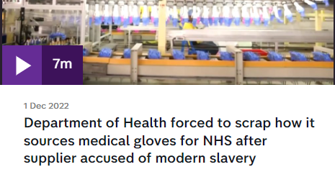
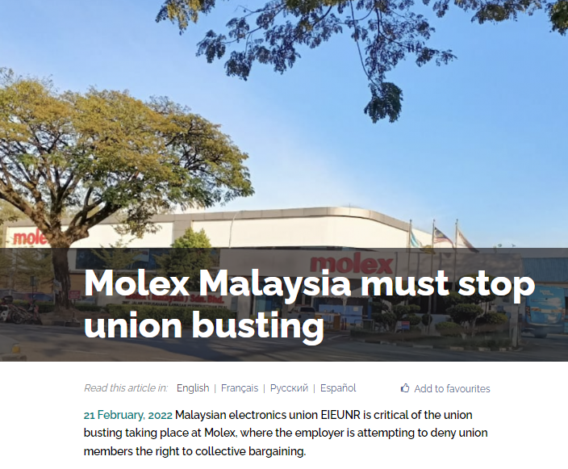
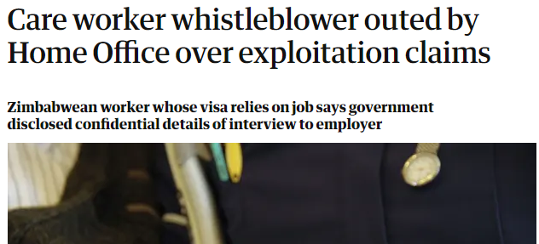
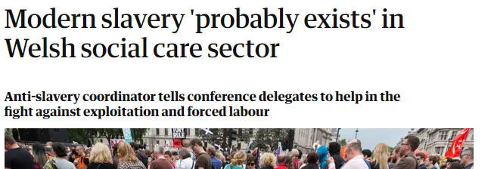
Notes:
North Wales incidence of recruitment agency modern slavery which has been found guilty by the GLAA
Zimbabwean social care worker who whistle blowed on her employer in an agency over illegal recruitment fees and exploitation to a Home Office investigation but was then outed by the Home Office after promising they would not.
Another is an incident of forced labour UNISON is working on in Scotland is another classic case which also illustrates just how unfit for purpose the MS Act is, in every way.
Molex is a global manufacturer of electronic, electrical and fiber optic connectivity systems for various industries like data communications, medical, industrial, automotive and consumer electronics.

Slide 4
Government duty to Protect
Public Procurement?
Business duty to respect

Slide 5
Corporate Justice Coalition BHREA Short Principle Element 8
Commercial and other organisations ….. includes public sector bodies, including those using public procurement and other public bodies providing financial and other support to businesses, such as export credit agencies, development agencies and development finance institutions.

Slide 6
How should the public sector be treated?
Not replicate private sector compliance but more than tick box
No civil or criminal liability
Regulator carrot and stick
Training, guidance, data platforms
Investigations
Fines
Remedy
Provision to revisit the new Procurement Bill and Health and Social Care Act

Slide 7
Where are we?
Campaign fund
Research
1st draft of the law
What’s next?
Writing up case studies
Consulting & policy development
Campaign plan
Influencing Labour
Notes:
Polling
Member awareness
Member activism

Slide 8
Q & A

Slide 9
Activity
Sit in your regional groups and agree a rapporteur
Consider the two case studies
How are the case studies relevant to UNISON members?
How could you get your branch to support the campaign?
How would you encourage members to sign the pledge and contact their MPs?
What do you need from the International Unit or Corporate Justice Coalition to help make your campaign effective?
20 minute activity
Be prepared to give a 3 minute presentation on your campaign plan and what support you’d like.

