Slide 1
YEAR OF BLACK WORKERS 2023 LGBT+ History Month Quiz
Notes:
Welcome to UNISON Year of Black Workers 2023 presentation for LGBT+ History Month February 2023
This year, 2023, is UNISON’s Year of Black Workers. Launched in January at National Black Members’ Conference.
This presentation provides a focus on Black LGBT+ issues during LGBT+ History Month, February 2023.

Slide 2
Year of Black Workers 2023: Black LGBT+ Network
Notes:
Greetings coming to you from our Black LGBT+ Network meeting at National Black Members Conference 2023 in Edinburgh which saw the launch of the Year of Black Workers 2023 (YOBW 23).

Slide 3
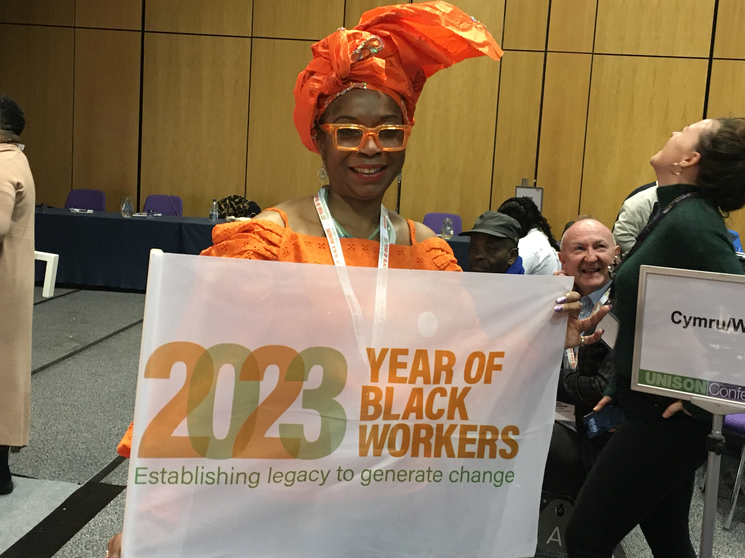
Question 1
Can you name all four UNISON Self Organised Groups?
Women
Black workers
Disabled workers
LGBT+
Notes:
Did you get them right? Have you got all 4 self organising groups in your Branch?
Equality is at the heart of UNISON. We challenge discrimination and win equality in the workplace and beyond. Everyone shares responsibility for equality in UNISON.
But our equality work includes groups for members who experience particular types of prejudice and discrimination.
These groups meet locally and nationally to discuss, campaign and organise around the specific issues that affect them. They help UNISON understand equality and meet our equality aims.

Slide 4
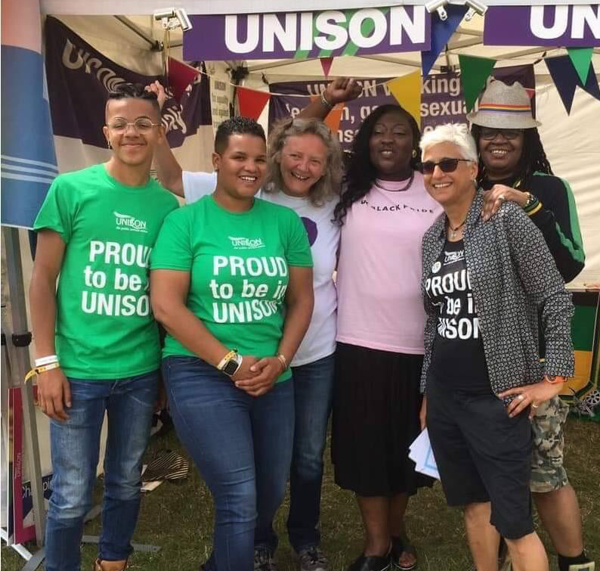
Question 2
What is LGBT+ History Month for?
“LGBT+ History Month is a chance to shed new light on the history of lesbian, gay, bi and trans people in the UK” (Stonewall)
Notes:
Did you get the answer right? Have you heard of LGBT+ History month before? Where? Have you attended an LGBT+ History month event before?

Slide 5
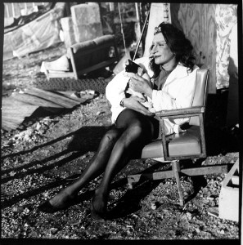
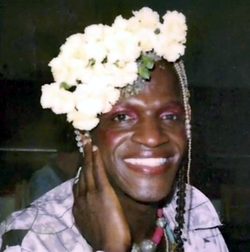
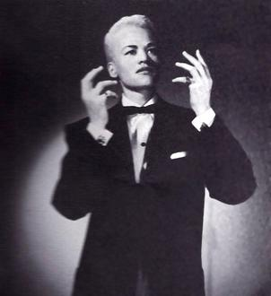
Question 3
Name these three Black activists who were key figures in starting LGBT+ Prides?
Marsha P Johnson
Stormé DeLarverie
Image credits – see notes
Sylvia Rivera
Notes:
Did you get them right?
Why don’t we find out a little more about each Black LGBT+ activist.
Marsha P Johnson by Pay It No Mind - Original publication: Pay It No Mind documentaryImmediate source: http://www.bet.com/celebrities/photos/2014/06/ten-transgender-people-you-should-know.html#!061114-celebs-transgender-Marsha-P-Johnson, Fair use, https://en.wikipedia.org/w/index.php?curid=47771737
Sylvia Rivera by http://srlp.org/srlp-office-re-open-srlp-10-still-happening/, Fair use, https://en.wikipedia.org/w/index.php?curid=38099161
Storme DeLaverie by It appears to have been scanned in from a newspaper advert. I cleaned it up some and increased the contrast. - Original publication: Promotional photo used in advertisements for the Jewel Box Revue and the subject&#039;s career as a singer.Immediate source: http://www.latinpost.com/articles/13634/20140528/storm%C3%A9-delarverie-death-stonewall-activist-known-as-the-rosa-parks-of-the-gay-community-dead-at-93.htm, Fair use, https://en.wikipedia.org/w/index.php?curid=47806794

Slide 6
Marsha P Johnson
Marsha was an American gay liberation activist and self-identified drag queen. Known as an outspoken advocate for gay rights, Johnson was one of the prominent figures in the Stonewall uprising of 1969. Johnson, alongside her good friend Sylvia Rivera, emerged from the clashes as leaders in the gay liberation movement. They helped found the group Street Transvestite Action Revolutionaries (STAR).
She is remembered as one of the most significant activists for transgender rights, although the term “transgender” wasn’t commonly used during her lifetime. Johnson identified as a “transvestite,” gay and a drag queen, and used she/her pronouns.
In remembering Stonewall it is important to recognise that Black LGBT+ people, galvanised a revolution that fought in solidarity for people regardless of their gender identity, sexual orientation, ethnicity or class.
Notes:
Marsha P. Johnson was an American gay liberation activist and self- identified drag queen. Known as an outspoken advocate for gay rights, Johnson was one of the prominent figures in the Stonewall uprising of 1969. Johnson, alongside her good friend Sylvia Rivera, emerged from the clashes as leaders in the gay liberation movement. They helped found the group Street Transvestite Action Revolutionaries (STAR), which offered housing to homeless and transgender youth.
She is remembered as one of the most significant activists for transgender rights, although the term “transgender” wasn’t commonly used during her lifetime. Johnson identified as a “transvestite,” gay and a drag queen, and used she/her pronouns.
In remembering Stonewall it is important to recognise that Black LGBT+ people, galvanised a revolution that fought in solidarity for people regardless of their gender identity, sexual orientation, ethnicity or class.
“Stormé, Sylvia and Marsha’s contributions to this historic event, needs to be highlighted and celebrated as we salute their bravery and activism in a politically hostile environment that could not prevent them from taking action.” (Bev Miller, Black Action, Summer 2020).

Slide 7
Stormé DeLarverie
Stormé was a butch lesbian born in New Orleans, to an African American mother and a white father and she was responsible for starting the first Stonewall riot at 1.20am on June 28 1969.
Stormé was hit on the head with a billy club and handcuffed. She was bleeding from the head when she brazenly turned to the crowd and hollered, “WHY DON’T YOU DO SOMETHING!?”
After a long struggle, Stormé was dragged into a police wagon and that’s when the scene exploded. That summer night a revolution began and it was a strong butch woman of colour that is reported to have thrown the first punch. Exactly one year later, on June 28, 1970, the first Pride parade took place.
Notes:
Stormé DeLarverie was a butch lesbian born in New Orleans, to an African American mother and a white father and she was responsible for starting the first Stonewall riot at 1.20am on June 28 1969.
Stormé was hit on the head with a billy club and handcuffed. She was bleeding from the head when she brazenly turned to the crowd and hollered, “WHY DON’T YOU DO SOMETHING!?”
After a long struggle, Stormé was dragged into a police wagon and that’s when the scene exploded. That summer night a revolution began and it was a strong butch woman of colour that is reported to have thrown the first punch. Exactly one year later, on June 28, 1970, the first Pride parade took place.
This information is taken from an article by Bev Miller, UNISON Black LGBT+ Network published in Black Action, Summer 2020.
If you liked this article, go to Black Members section on UNISON website to find more like this. Also see Out In UNISON for on LGBT+ members’ section for more LGBT+ articles.

Slide 8
Sylvia Rivera
When Sylvia threw the second Molotov cocktail at Stonewall, she was only 17. Stonewall incited Rivera to keep fighting for voices marginalised within the gay rights space. She became involved with the Gay Liberation Front, and the Gay Activists’ Alliance, and challenged the way the predominantly white gay and lesbian community approached activism from a middle-class perspective.
Rivera wanted their activism to be more progressive, to include in their fight the rights of transgender individuals, people of colour, the homeless, and the incarcerated. She also working with Puerto Rican activist organization the Young Lords, hoping the Puerto Rican and Latina communities would acknowledge the reality of gay and trans people.
Defiant of labels, Rivera fought for not only gay and trans rights but also racial, economic and criminal justice issues.
Notes:
When Sylvia Rivera threw the second Molotov cocktail at Stonewall, she was only 17. But Stonewall incited fervour in Rivera to keep going, to keep fighting for voices marginalised within the gay rights space. She became involved with the Gay Liberation Front, or GLF, and the Gay Activists’ Alliance, GAA, and challenged the way the predominantly white gay and lesbian community approached activism from a middle-class perspective.
Rivera wanted their activism to be more progressive, to include in their fight the rights of transgender individuals, including people of colour, the homeless, and the incarcerated. But she challenged multiple communities through her activism, also working with Puerto Rican activist organization the Young Lords, hoping the Puerto Rican and Latina communities would acknowledge the reality of gay and transgender people.
Defiant of labels, Rivera confounded many in the mainstream gay liberation movement because of her own diverse and complex background: She was poor, trans, a drag queen, a person of colour, a former sex worker, and someone who also experienced drug addiction, incarceration and homelessness. For all of these reasons, Rivera fought for not only gay and trans rights but also racial, economic and criminal justice issues.

Slide 9
Question 4
Can you name a London-based Trans campaigning organisation which draws inspiration from Marsha P Johnson?
Black Trans Alliance
“BLA’s mission is to support, protect and amplify the voice of black transgender persons in London and the wider community; through advocacy, education, visibility and empowerment.”
#BlackLivesMatter
Notes:
Have you heard of the UNISON Trans Equality campaign? To get Trans Equality badges, see the UNISON website resources for LGBT+ members.
Black Trans Alliance, states that as an LGBTQ+ organisation they “understand that liberation is not given and must be fought for. We express our indebtedness to our own Marsha P. Johnson a Black trans woman who helped to ignite the LGBTQ+ movement in 1969. This is a movement that has continued over the past 50 years, fighting for LGBTQ+ rights. We have stood against discrimination and violence; therefore we know the fight for justice is not easy and cannot be won alone.
We unequivocally stand with the global Black Lives Matter Movement and join in the destruction of racism that is embedded in society.”
Black Lives Matter | Black Trans Alliance

Slide 10
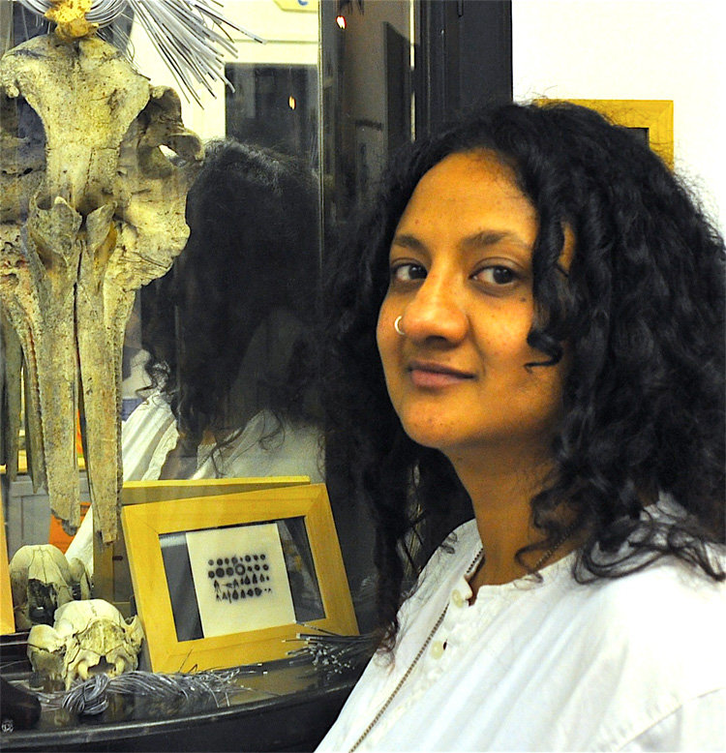
Question 5
Which activist co-founded the first LGBTQ+ South Asian campaigning group?
In 1987, Poulomi Desai co-founded the first South Asian LGBTQI+ campaigning group, Shakti and the Naz Foundation International, the first HIV/AIDs charity in India, in 1991.
Notes:
Poulomi Desai
Poulomi is a photographer, multimedia artist, curator and activist. As just a teenager, she founded the Hounslow Arts Cooperative Theatre of which one piece in particular, a cabaret based touring show titled On the road to nowhere, looked at race, power, sexuality and gender and was both highly influential and deeply controversial.
In 1987, Poulomi also co-founded the first South Asian LGBTQI+ campaigning group, Shakti and the Naz Foundation International, the first HIV/AIDs charity in India, in 1991. Poulomi also organised the first London south Asian LGBTQI+ poetry festival. She also spent many years photographing queer south Asian communities from London, Bangaldesh and Gujarat. The images were compiled together in an exhibition and book titled Red Threads: The South Asian Queer Connection in Photographs.

Slide 11
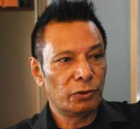
Question 6
Who successfully challenged Section 377 of the Indian Penal Code?
Shivananda Khan an LGBTQI+ rights activist, most notable for his successfully challenge of India’s Section 377, which criminalised gay sex, in the high court in 2009.
Notes:
Part of the colonial legacy left by the British in India is the Indian Penal Code. This refers to Section 377 of that Code which you may have heard of in the news.
Shivananda Khan was an LGBTQI+ rights activist. His most notable achievement was when he successfully challenged India’s Section 377, which criminalised gay sex, in the high court in 2009. Alongside Poulomi Desai, he founded Shakti, the UK’s first LGBTQI+ rights group and NAZ, a HIV/AIDS charity in India. Shivananda also created education programs to address the way people in Asia see gender and sexuality. This resulted in the Asia Pacific Coalition on Male Sexual Health that brings together governments and the United Nations to address health and social development with regards to HIV-AIDS. He was awarded an OBE in 2005.

Slide 12
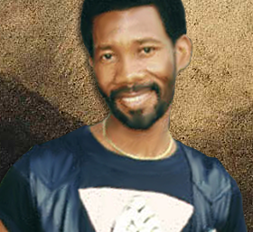
Question 7
Who formed the Saturday Group, the first black gay group in Africa?
Simon Nkoli was one of Africa’s most prominent gay and AIDS activists.
He was activist against Apartheid and helped change attitudes of the African National Congress. He also founded GLOW.
Notes:
Simon Tseko Nkoli was born in Soweto South Africa in 1957. He was one of Africa’s most prominent gay and AIDS activists.
After a 1976 uprising in his homeland he became an activist against Apartheid. In 1983, Simon joined the primarily white Gay Association of South Africa (GASA), but would not accept the racism he encountered there, just as he would not accept the homophobia he had previously experienced in his activism against Apartheid. As a result he eventually formed the Saturday Group, the first black gay group in Africa.
In 1984 he was arrested, along with 21 other political activists, and faced the death penalty for treason. Simon continued to stand up for gay rights while a prisoner, which helped to change the attitudes of the African National Congress. He was acquitted and released from prison in 1988. That same year he founded the Gay and Lesbian Organisation of the Witwatersrand (GLOW), which organized South Africa’s first Gay and Lesbian Pride Parade in 1990.
He also represented the African region as a member of the International Lesbian and Gay Association board, and was one of the first gay activists to meet with President Nelson Mandela in 1994.
Simon died with an AIDS-related illness in 1998 aged 41.

Slide 13
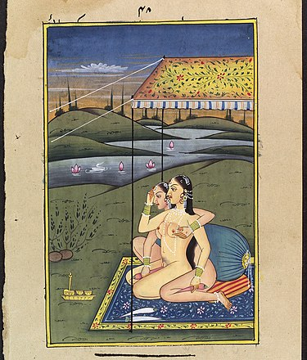
Question 8
When were same sex relationships/same gender sexuality ruled legal in India?
On 6 September 2018, the Supreme Court unanimously ruled that Section 377 was unconstitutional as it infringed on the fundamental rights of autonomy, intimacy, and identity, thus legalising homosexuality in India.
Notes:
The Indian Supreme Court reviewed the legal validity of s.377 of the Indian Penal Code, which had been introduced under British Colonial Rule.
Activists view the case as the most significant and "greatest breakthrough for gay rights since the country's independence", and it could have far-reaching implications for other Commonwealth countries that still outlaw homosexuality.
On 6 September 2018, the Supreme Court issued its verdict. The Court unanimously ruled that Section 377 is unconstitutional as it infringed on the fundamental rights of autonomy, intimacy, and identity, thus legalising homosexuality in India. The Court explicitly stated that criminalising carnal intercourse is irrational, arbitrary and manifestly unconstitutional.
— Chief Justice Dipak Misra

Slide 14
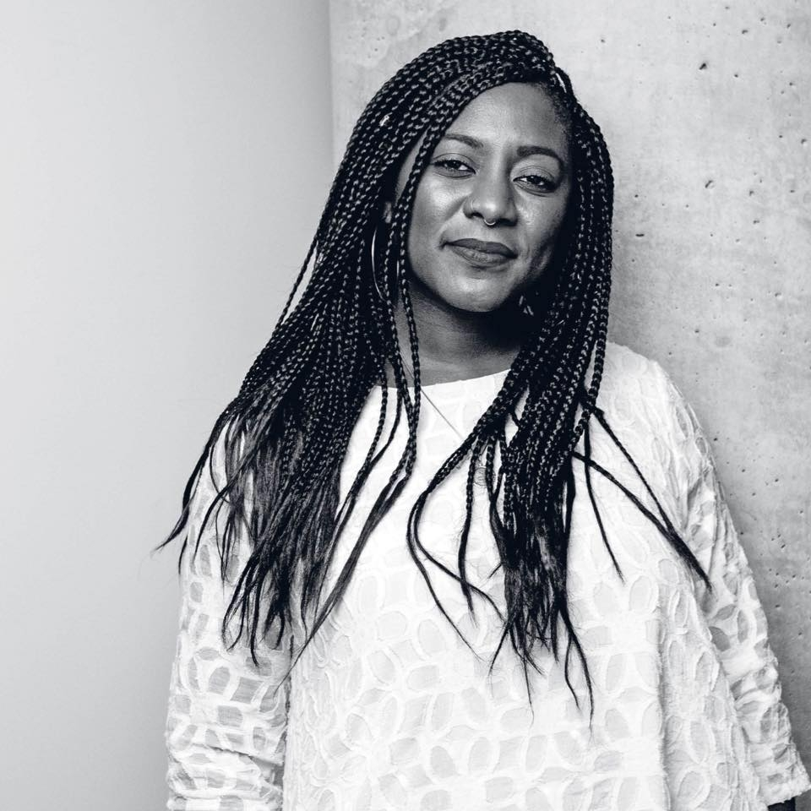
Question 9
Can you name the Lesbian co-founder of the Black Lives Matter movement?
Alicia Garza is the co-creator of the Black Lives Matter Global Network, and the Strategy & Partnerships Director for the National Domestic Workers Alliance. Alicia warns: #tags don’t start movements — people do.
Notes:
Have you head of the Black Lives Matter movement? Have you taken part in any Black Lives Matter events or protests?
Statement from BLM website: About - Black Lives Matter
#BlackLivesMatter was founded in 2013 in response to the acquittal of Trayvon Martin’s murderer.
Black Lives Matter Global Network Foundation, Inc. is a global organization in the US, UK, and Canada, whose mission is to eradicate white supremacy and build local power to intervene in violence inflicted on Black communities by the state and vigilantes.
By combating and countering acts of violence, creating space for Black imagination and innovation, and centering Black joy, we are winning immediate improvements in our lives.
We affirm the lives of Black queer and trans folks, disabled folks, undocumented folks, folks with records, women, and all Black lives along the gender spectrum. Our network centers those who have been marginalized within Black liberation movements.
We are working for a world where Black lives are no longer systematically targeted for demise.
We affirm our humanity, our contributions to this society, and our resilience in the face of deadly oppression.
The call for Black lives to matter is a rallying cry for ALL Black lives striving for liberation.
ALICIA GARZA
Alicia believes that Black communities deserve what all communities deserve — to be powerful in every aspect of their lives. An innovator, strategist, organizer, and cheeseburger enthusiast, Alicia founded the Black Futures Lab to make Black communities powerful in politics. She is the co-creator of #BlackLivesMatter and the Black Lives Matter Global Network, the Strategy & Partnerships Director for the National Domestic Workers Alliance, and the co-founder of Supermajority, She shares her thoughts on politics and pop culture on her podcast, Lady Don’t Take No. Alicia warns you: hashtags don’t start movements — people do.

Slide 15
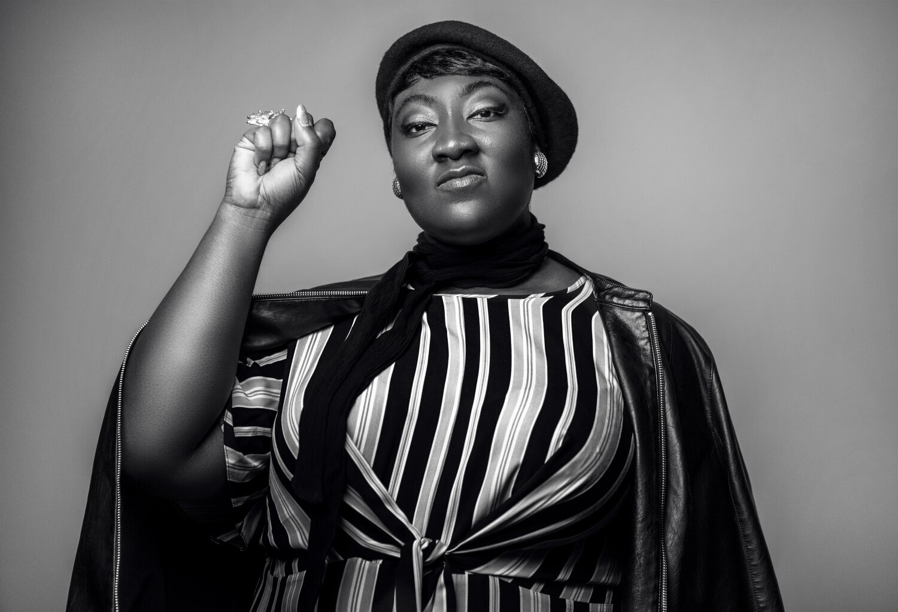
Question 10
Can you name the co-founder of UK Black Pride?
Phyllis Opoku-Gyimah also known as ‘Lady Phyll’ is a dedicated trade unionist.
She set up UK Black Pride to promote unity and co-operation among all Black people who identify as LGBT+.
Notes:
Phyllis Opoku-Gyimah also known as ‘Lady Phyll’
Lady Phyll is a dedicated trade unionist. She worked for many years at the Public and Commercial Services (PCS) Trade Union. She spent a decade advocating for the rights of workers within the union, including as a negotiator on behalf of Civil Service workers and as the Head of Equality and Learning and Political Campaigns. She has been a member of the LGBT and Race Relations Committees of the Trade Union Congress (TUC) for many years and works for LGBT+ rights internationally within ILGA ( International Lesbian and Gay Association).
Lady Phyll is an equalities campaigner who wants people to be aware of the injustices facing the Black LGBT+ community. They face both racism and homophobia. She says intersecting and overlapping oppressions result in great inequalities. She set up UK Black Pride to promote unity and co-operation among all Black people of African, Asian, Caribbean, Middle Eastern and Latin American descent who identify as lesbian, gay, bisexual or trans. It provides the space and support for black LGBT+ people and their friends and families, to come together. It celebrates their achievements and encourages the wider LGBT+ community to be more inclusive.
Lady Phyll is an Executive Director of the Kaleidoscope Trust which is a UK charity supporting the human rights of LGBT+ people around the world. She is on the Board for Justice for Gay Africans. She was also a trustee of Stonewall until 2019, when Stonewall and UK Black Pride started to work more closely. She has won many awards including the European Diversity Awards Campaigner of the Year in 2017.
Lady Phyll has supported UNISON at many events and conferences throughout the years.

Slide 16
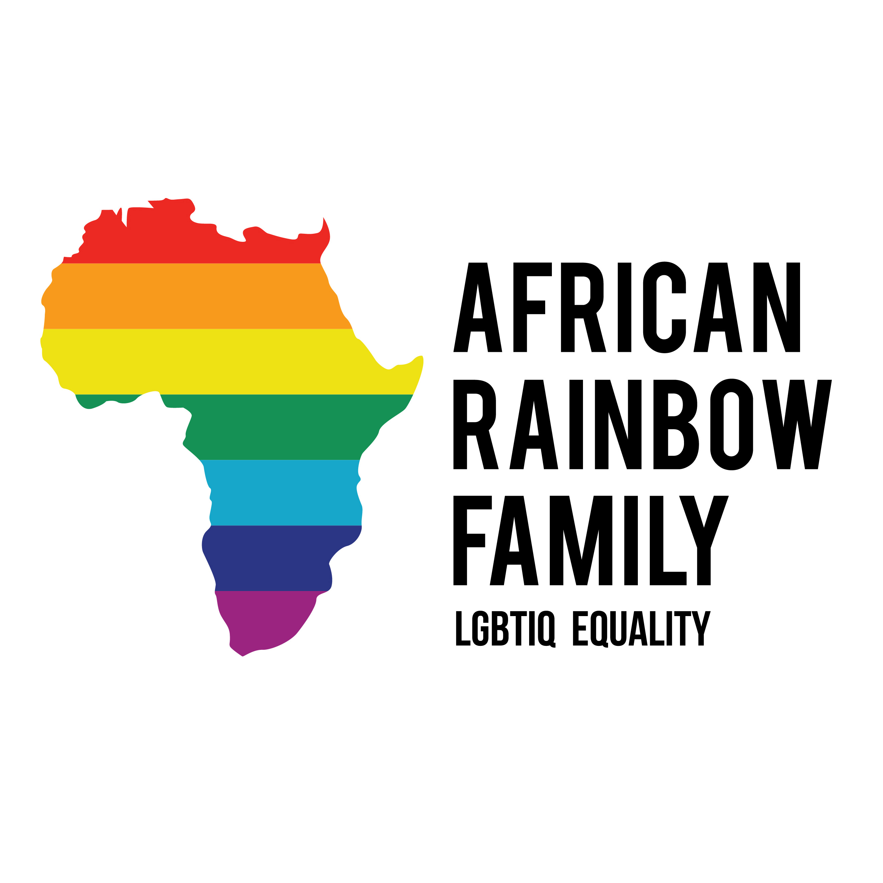
Question 11
What is African Rainbow Family?
African Rainbow Family is a charity that supports LGBTIQ people of African heritage including refugees, LGBTIQ people seeking asylum and the wider BAME in the UK.
Notes:
African Rainbow Family is based in Manchester. It is a charity that supports LGBTIQ people of African heritage including refugees, LGBTIQ people seeking asylum and the wider BAME in the UK. Responding especially, in the wake of the growing toxic anti-gay persecutions they face for their sexual orientation and gender identity.

Slide 17
Question 12
Who is the founder of African Rainbow Family?
Aderonke Apata has gone from being an asylum seeker detained in Yarlswood detention centre, to a leading human rights activist in the UK, for Black LGBT+ rights in the UK and across the world.
Notes:
In a few short years, Aderonke has gone from being an asylum seeker detained in Yarlswood detention centre, to a leading human rights activist in the UK, for Black LGBT+ rights in the UK and across the world.
Since she arrived from Nigeria to the UK in 2011 and was placed in detention, Aderonke has campaigned for the rights of asylum seekers and highlighted the predicament of LGBT+ asylum seekers in the UK and for the human rights of LGBT+ people around the world. Aderonke was not believed by Borders UK when she said she was a lesbian and at risk in Nigeria as anyone who is LGBT+ would be. She challenged the racism and LGBT+ phobia of the system by organising the first peaceful protest by asylum seekers at Yarlswood detention centre just months after arriving there. Building solidarity, protest and a movement is something that Aderonke has done repeatedly, often in partnership with UNISON. Aderonke campaigned with UNISON, speaking at our conferences and Network meetings. She brought the message of wherever she went that if we want human rights, if we want justice, we need to fight for them. After building a campaign highlighting the layers of racism and LGBT+ phobia she faced, Aderonke won her own asylum case.
In 2016 Aderonke contributed to an all-party parliamentary report on ‘UK stance on international breaches of LGBT rights’. She highlighted the roots of LGBT+ phobia in colonial laws arguing ‘Don’t forget that most of these countries that criminalise LGBT people inheirited these anti LGBT laws from their colonial master, Britain. It is imperatively important therefore, that the UK apologises for the pains and agony caused to LGBT people as a result of this archaic law’
Through association with UNISON, Aderonke became a delegate to ILGA World (International Lesbian and Gay Association), a world-wide movement of trade unions and campaign groups, for LGBT+ rights.

Slide 18
Question 13
Who was the first out gay male chair of the National Black Members Committee?
Kursad Kahramanoglu.
This is a picture of Kursad representing UNISON at the launch of the Lesbian and Gay Coalition Against Racism.
Notes:
Thinking about our Black LGBT+ legacy:
Who was the first out Gay male chair of National Black Members Committee?
(Our slogan for the Year of Black Workers, underlining everything we do is Establishing Legacy to generate change)
Anyone remember? Kurshad Kahramanoglu. A legend remembered by many still in the Black LGBT+ Network and throughout UNISON and the Trade Union movement.
It’s important to remember that we build on legacy and stand on the shoulders of people who have gone before us.. In UNISON, in our families and communities.

Slide 19
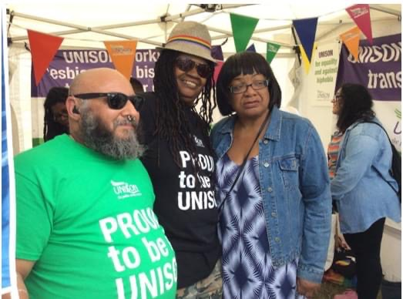
Question 14
Who was the first woman chair of National Black Members Committee, from the LGBT+ Network?
Bev Miller pictured here in the middle with Dave Merchant (LGBT+ National Committee) and Diane Abbott MP at UK Black Pride a few years ago.

Slide 20
Question 15
Name the country of origin & the field of achievement for the these LGBT+ figures
Josephine Baker
James Baldwin
Laverne Cox
Angela Davis
Pratibha Parmar
Sunil Gupta
David Kato
Jackie Kay
Cleo Kambugo
Suniti Namjoshi
US/French, performer/spy
US, playwright / novelist
US, actress / activist
US, activist
UK, film maker, producer and writer
UK, Photographer activist
Ugandan, teacher LGBT activist
UK, playwright/ poet/ novelist
Ugandan, actress / activist
Indian, feminist novelist / gay activist
Notes:
Josephine Baker - African American Bisexual singer, dancer, anti-racist rights activist
James Baldwin – African American Gay man, writer, intellectual, anti-racist and human rights activist
Laverne Cox – African American, Transgender woman, best known for role in Orange is the New Black – Sophia Burset – in 2014 was the first openly Transgender person to be nominated for an acting Emmy
Angela Davis - An African American woman, she is lesbian and a vocal champion for race equality and LGBT+ rights. In the 1960s Angela was dismissed from the faculty of the University of California due to her membership in the Communist Party and with her involvement in the Black Panther Party. She was acquitted on charges of theft, kidnapping and murder.
Pratibha Parmar - Pratibha is lesbian, was born in Kenya, of Indian decent, moving to England when she was 11. She was an active member of the pioneering publishing collective, Sheba Feminist Press where she campaigned to publish works by Black women.
Pratibha is author and editor of several books, including The Empire Strikes Back (1982) Queer Looks (1993) and Warrior Marks (1997) (with Alice Walker).
Her films include Nina’s Heavenly Delights (2006/7)– a lesbian curry romance and Khush (1991) portraying lesbians and gay men from India and other parts of Asia, discussing their coming out and their acceptance and embracing of their sexuality. Khush also discusses homosexuality in the Indian diaspora.
Sunil Gupta – Indian born Canadian photographer based in London. A gay man, he joined his university gay rights movement in the 1970s and founded the Association of Black Photographers in 1988.
David Kato – Ugandan gay man, LGBT+ rights activist. Considered the father of Uganda’s gay rights movement. Murdered in 2011 after a magazine called for him to be killed. This was not before he successfully sued that publication.
Jackie Kay – Scottish, of Scottish and Nigerian heritage. Lesbian, poet, novelist, playwright. Wrote poetry collection ‘The Adoption Papers’ 1991 and ‘Red Dust Road’ 2011, autobiography. She is Professor of Creative Writing at Newcastle University
Cleo Kambugo - Ugandan Transgender woman and human rights activist. Her advocacy was recognised in 2016 documentary The Pearl of Africa
Suniti Namjoshi – Indian now living in England. Lesbian writer, satirist, poet, academic. Noted for The Blue Donkey Fables 1988 and childrens’ stories featuring Aditi. Her work playfully challenges, sexism, racism and lgbt+ phobia.

Slide 21
Thank-you for play the quiz…
Now go to UNISON website LGBT+ page to find and discuss Trans Allies Guidance (unison.org.uk)
HAPPY LGBT+ HISTORY MONTH
Notes:
Throughout YOBW 23 keep looking at UNISON Black Members and LGBT+ sections of website for further Black LGBT+ news.

