Slide 1
Our proud history:
From lone voices to collective union action for LGBT+ equality
Notes:
NOTE TO PRESENTERS
The notes pages of these slides should include enough information for any activist to show this presentation.
Where there is text on the slides, you should read that out before telling people what is on the notes page. This doesn’t apply where the slides are pictures of old publications. For them, the notes should be enough.
It is quite a long presentation, so you may want to select some of the slides, according to your audience.
If you have questions about any of the information, please email Mitchell Coe m.coe@unison.co.uk or Susan Mawhood s.mawhood@unison.co.uk, UNISON LGBT+ equality officers, who will make every effort to clarify!

Slide 2

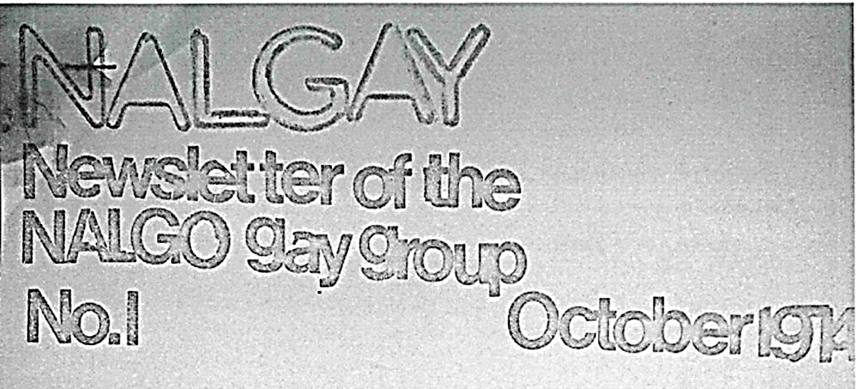
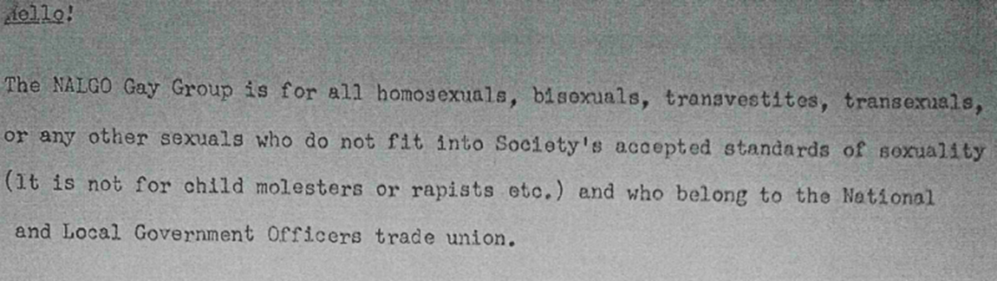
1970s
NALGO policy:
‘Sexual orientation’ to be included in non-discrimination clauses in all collective agreements
Notes:
This is where our story starts. Lets think about what it was like to be LGBT+ in the early 70s:
No positive equality rights for LGB or T workers or service users – you could be sacked or refused services, perfectly lawfully
No equal age of consent anywhere in the UK
Male homosexuality only partially decriminalised in England and Wales since 1967
Still completely criminalised in Scotland, Northern Ireland and Isle of Man
North Western Committee for Homosexual Law Reform, formed in 60s to campaign for decriminalisation, changed its name to the Campaign for Homosexual Equality (CHE) in 1971
1974
In 1974, CHE called a conference to look at workplace rights for lesbians and gay men
Howard Hyman, member of NALGO Nottingham Health branch, was at the conference
NALGO was the National and Local Government Officers Association
NALGO and sister unions COHSE (Confederation of Health Service Employees) and NUPE (National Union of Public Employees) were the three unions that came together in 1993 to form UNISON
Following the CHE conference, Howard wrote to the NALGO’s magazine, Public Service, suggesting a NALGO gay group
He said ‘I can’t believe I am the only one...’ That text says: ‘The NALGO Gay Group is for all homosexuals, bisexuals, transvestites, transsexuals or any other sexuals who do not fit into this society’s accepted standards of sexuality (it is
not for child molesters or rapists etc) and who belong to NALGO.’
For next couple of issues, Public Service’s letters page became a pitched battle between those who clearly saw lesbian and gay rights as workers rights and those who saw homosexuality as a sin, a crime, a disease ... Or all three.
This publicity built a firm base of members across the country, who started meeting and organising
First Nalgay newsletter, published by Howard Hyman in October 1974. ‘It exists to show the union just how many homosexuals there actually are in the union and works to try to change attitudes within the work situation. It will
support those who may be victimised in any way due to their sexual orientation and bring pressure to bear within NALGO.’
Howard remained an important part of the group in its early years
1975
Issues started being taken up at different levels in the union eg
In 1975, NALGO member and social worker Ian Davies was sacked by London Borough of Tower Hamlets because he was gay, or in the words of the employer ‘jeopardy to the community’.
An industrial tribunal found he had been unfairly dismissed, based on the circumstances of the case, but the Council ignored this
His immediate colleagues walked straight out on strike, the branch recommended it become an official dispute and two weeks later, the NALGO exec backed the recommendation – the first official strike over the sacking of a gay worker
1976
Individual cases were quickly translated into national policy
Action from members of the lesbian and gay group led to a successful motion at the 1976 Annual Conference:
“This conference instructs all NALGO negotiators to add ‘sexual orientation’ to the non-discrimination clause in all collective agreements. In addition it calls upon the National Executive Council to propose the appropriate addition to the TUC model clause [on equal opportunities in employment].”
The text was agreed first at a meeting of lesbian and gay members in London, then sent out to friendly branches
Camden branch adopted it as its own policy then submitted it to the whole union conference, where it was agreed
However, it took many years for this negotiating aim to be achieved in full - many employers refused to act until forced to by change in law
In one negotiating body, a Tory councillor talked about the dangers office boys would run if the proposal was accepted by employers

Slide 3
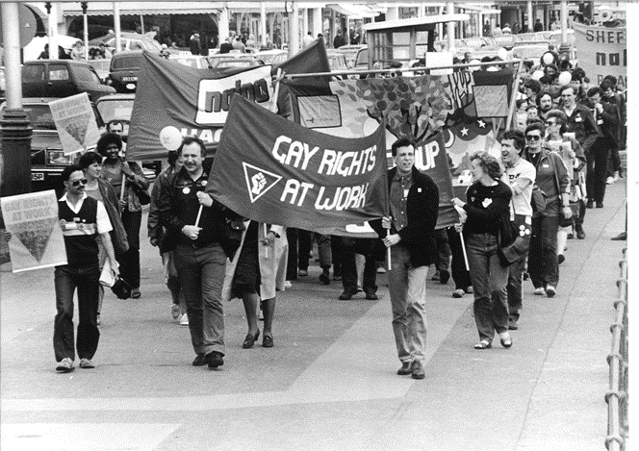
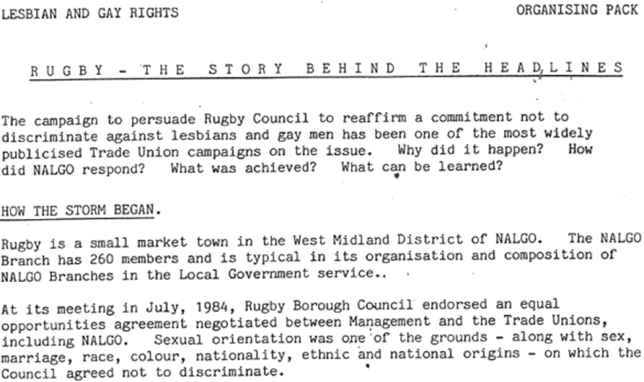
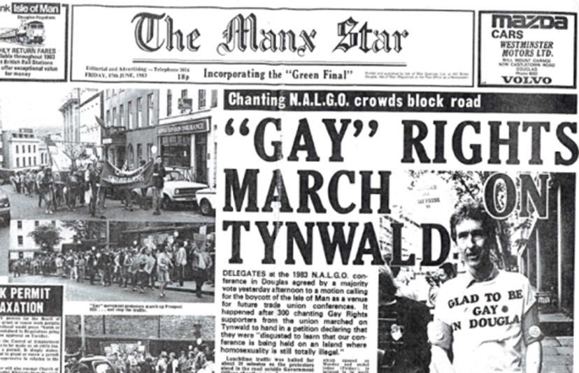
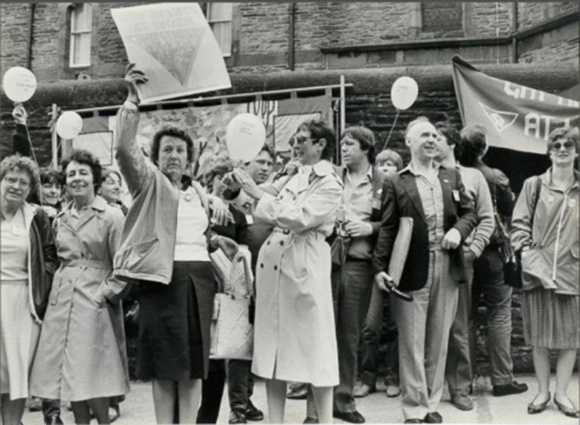
1980s
Notes:
NALGO’s sister unions COHSE and NUPE were also early adopters of lesbian and gay rights, defending members facing discrimination and campaigning on lesbian and gay equality issues, including the many campaigns for legal reform that followed over the next decades
Jamie Dunbar – COHSE - hospital porter
sacked for wearing a gay pride badge
COHSE was the first union to issue advice
on HIV in the workplace – facts not myths
Susan Shell – NUPE – care worker
sacked when she came out to a colleague
By early 1980s, lesbian and gay meetings were well established and flourishing in NALGO
So when NALGO took its annual conference to Douglas on the Isle of Man in 1983, they were well placed to mobilise protests
Male homosexuality was still completely criminalised in the Isle of Man at that time
Jackie Lewis from Lambeth branch remembers:
“ We distributed hundreds of leaflets and collected signatures on a petition to the Manx government. Many delegates wore our badges and stickers with slogans such as ‘GAY OK’ and ‘Glad to be gay in Douglas’. Lesbian and gay pride helium balloons were dotted around the conference hall. Around 200 delegates attended the national equal opportunities committee (known as NEOC) fringe meeting on gay rights. Then on Thursday lunchtime, about 300 delegates carrying banners and those balloons, marched along the promenade, through the main shopping centre to the government building to deliver the petition.
This photo of conference delegates on the protest march includes two future presidents of the union.
On the far right facing us in the dark glasses is Rita Donaghy (now Baroness Donaghy!).
Rita was a great ally of lesbian and gay rights from the start. She was NALGO president 1989-90. She went on to be TUC president and then eventually chair of ACAS.
Her CBE was for services to employment relations.
The guy facing us next to Rita with the brolly in his hand is Mike Blick
It was Mike who had drafted that 1976 motion on lesbian and gay rights that became NALGO policy later that year.
He became NALGO president in 1991, so far as we know, the first out gay trade union president in the UK.
Jackie continues:
“although the large majority had never been on a gay rights march before, they took immediately to chants such as:
Give us a G, give us an A ... What have you got? GAY!
2-4-6-8 Is that copper really straight?
What do we want? Law reform. When do we want it? NOW!
Neither NALGO nor the Isle of Man had ever seen anything quite like it.
The conference decided that afternoon that it would not return to Douglas until the law changed. This attracted considerable press attention – and was followed by similar decisions from other unions, including COHSE.”
October 1983
First national trade union lesbian and gay conference
Organised by NALGO Met L+G group, endorsed by NEOC
The impetus from the Douglas conference led to the first officially endorsed lesbian and gay conference in a UK union, which took place in Camden, London
Attended by 70 lesbian and gay NALGO members, it planned the way forward
One slight hitch nearly stopped the whole event
Camden Council’s insurers, the Sun Alliance, refused to insure the premises for the weekend, saying they were ‘not in the habit of insuring brothels’!
But NALGO’s own insurance brokers stepped in and all was well
An example in the lesbian and gay rights organising pack at the time showed how the union put its policies to action, working in alliance with lesbian and gay community groups.
In July 1984, the unions negotiated an anti-discrimination agreement with Rugby Borough Council which included sexual orientation, alongside other grounds.
That September, ten councillors called for the deletion of sexual orientation, a proposal as carried with 20 in favour, 19 against and 6 abstentions. The mover of the motion argued the agreement suggested Rugby Council ‘positively welcomed child molesters and perverts’. The leader of the council went on TV and radio and spoke to the national press, making appalling anti-gay statements.
NALGO issued public statements in protest at national, district and branch level and NALGO banners led a thousand strong protest march, along with the Gay Youth Movement, Campaign for Homosexual Equality and Gay Switchboard. But the council didn’t want to lose face and held its position.
Finally, after negotiations by NALGO with key councillors, a new sexual orientation anti-discrimination clause was agreed in February 1985.

Slide 4
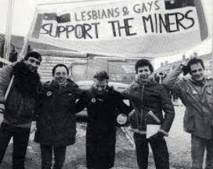
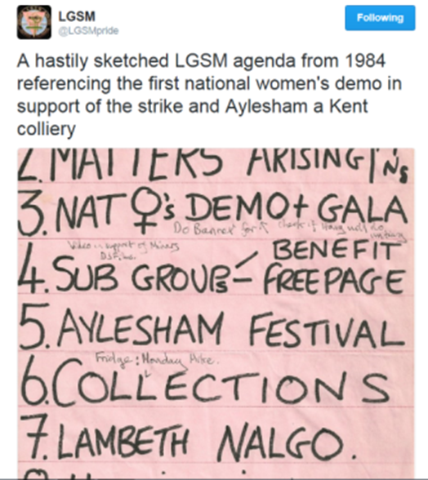
Notes:
So unions began to support lesbian and gay workers
And some lesbians and gay men did a great deal to support striking union members
See item 7 of what it says here was a hastily sketched Lesbians and Gays Support the Miners (LGSM) meeting agenda from 1984:
Lambeth NALGO
We were pleased to see this in a tweet from LGSM, which was reconvened to mark the thirtieth anniversary of the 1984-85 strike and continues to fight for workers’ and trade union rights
This story of Lesbians and Gays Support the Miners, set up during the year-long 1984 -85 miners strike, has now been well told and brought to the fore by the film Pride and now by the book Pride: The Unlikely Story of the True Heroes of the Miner's Strike, published in 2017 by John Blake

Slide 5
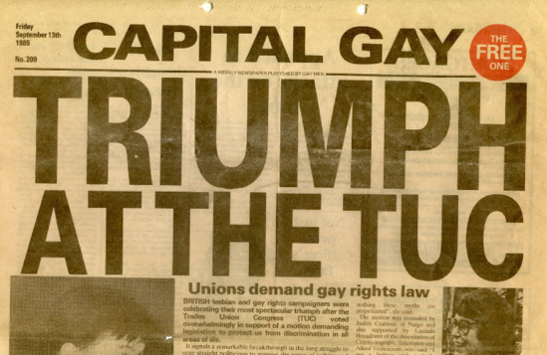
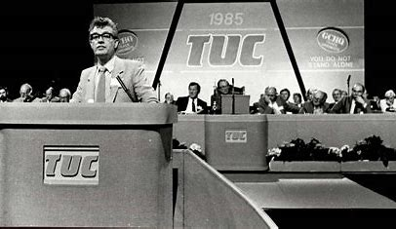
Taking it to the TUC
Notes:
NALGO, COHSE and NUPE also played a big part in getting lesbian and gay rights adopted by the TUC, the umbrella body for British trade unions, along with crucial support from the NUM.
Activist Chris Creegan recalls:
“It was September 1985. We had persuaded my union, NALGO, to second a motion on gay rights at the TUC conference in Blackpool. I was co-chair of NALGO’s fledging national lesbian and gay committee back then.
We weren’t part of the union’s official structures but we were knocking on the door and had raised some funds to organise a fringe meeting to galvanise support for the motion. Six people came.
Such was the draw of a gay event at a mainstream union conference in those days.
No matter, though, because the next day the motion was carried. And with the support of the mighty NUM itself in solidarity for all the work that LGSM had done. For the first time, the TUC had a comprehensive policy on gay rights.”

Slide 6
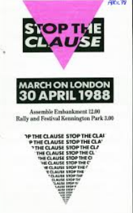

1988 - resisting Section 28
Notes:
The lesbian and gay movement was growing in visibility and confidence, in metropolitan areas at least. Through union and community organising, increasing numbers of local authorities and other public sector employers agreed lesbian and gay equality policies and supported lesbian and gay community groups. Some councils even appointed lesbian and gay equality officers.
This was too much for the Tory government under Margaret Thatcher. They saw this as a moral outrage and a threat to the family that must be legislated against
Section 28 said a local authority "shall not intentionally promote homosexuality or publish material with the intention of promoting homosexuality" or "promote the teaching in any maintained school of the acceptability of homosexuality as a pretended family relationship".
The lesbian and gay community and its supporters were outraged and mobilised as never before. One of the most famous protests was the night before Section 28 came into effect, when a group of lesbians abseiled into the House of Lords and invaded the live BBC Six O'Clock News, with one woman chaining herself to newsreader Sue Lawley’s desk. You can see some great clips on Youtube!
Section 28 of the Local Government Act 1988 (Section 2A in Scotland) sought to ban the ‘promotion of homosexuality’ and ‘pretend families’ by local authorities
The unions were at the forefront of the fight against its introduction and then the fight against its use and for its repeal
The Section was always a legal nonsense: it was never clear what ‘promote homosexuality’ actually meant.
But it had a serious chilling and censoring effect, and gave great confidence to those opposed to lesbian and gay equality.
Our unions pledged to run active campaigns against Section 28, seeking agreements with employers to guarantee no discrimination against lesbian and gay staff and for local authorities to reaffirm their commitment to lesbian and gay rights. The unions pledged to defend any members victimised for refusing to implement Section 28 and defend services to lesbians and gay men and the jobs of members providing those services.
There were a number of successful campaigns by NALGO to demand local authorities reverse their withdrawal of support for services. One reversed a threat to the Skelmersdale ‘1 in 10’ lesbian and gay youth group. Another successfully challenged the Newcastle City Council legal officer instruction that information on lesbian and gay books, organisations and pubs be removed from an information pack for young people.
Alongside these local campaigns, we continued to campaign and lobby for its repeal.
Section 28 was finally repealed under Labour in 2000 in Scotland and in 2003 in England and Wales.

Slide 7
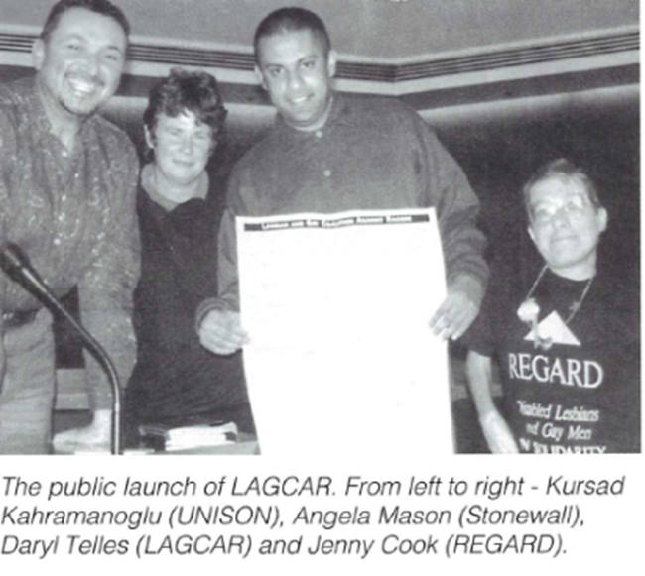
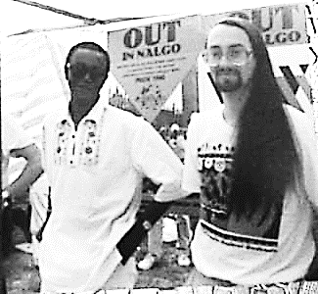
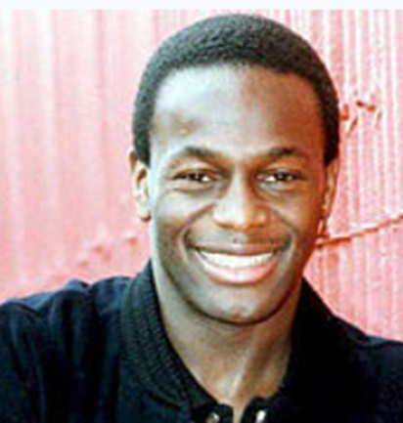

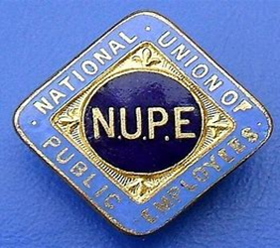
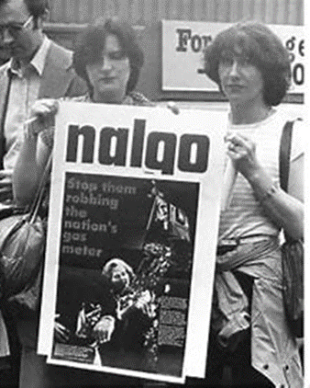
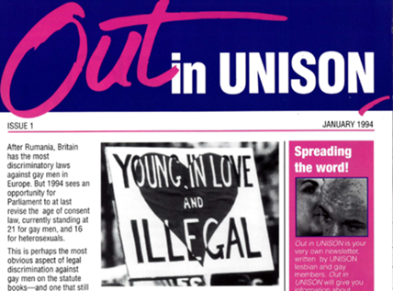
1990s
Notes:
We just felt the need to include this photo of the Out in NALGO stall from Pride 1990.
The union group ran many successful campaigns, and supported many others, led by its activists
Two such activists were Ted Brown and Dirg Aaab Richards, Black caucus reps on the NALGO’s national lesbian and gay steering committee
The Voice newspaper had published a series of homophobic articles, attacking and ridiculing Black lesbians and gay men
This included an unsympathetic article about Justin Fashanu, pictured above
At the time – and for many years since – Justin was the only out professional football player
The Voice had a large appointments section and adverts were an important part of its income, largely from ‘equal opportunities’ employers such as local authorities at voluntary organisations
Ted and Dirg set up Black Lesbians and Gays Against Media Homophobia and – among many other campaigns - organised a boycott of The Voice
Eventually, following a meeting between these campaigners, representatives of NALGO and directors of The Voice,
The paper printed a full page ‘right of reply’ by Black lesbians and gay men, a more balanced interview with Justin Fashanu, and amended their own equal opportunities policy to protect lesbian and gay staff at The Voice
So the boycott was lifted in September 1991
In June 1993, COHSE, NALGO and NUPE merged to form UNISON
The lesbian and gay organising established in the former partner unions was enshrined in UNISON’s rules from the start
The first issue of Out in UNISON swiftly followed in January 1994
The lead article called for equalisation of the age of consent (which was not finally won till 1998)
Other articles were on training for trade unionists on lesbian and gay workplace issues, how to get involved in the lesbian and gay group, and news from Northern Ireland
UNISON enshrined the best of the traditions of the three partner unions
This included a rule book commitment to fair representation in all UNISON structures and activities
So not only did lesbians and gay men have the right to organise at national, regional and branch level
We also had the duty to make sure our group was fully inclusive of the diversity of lesbian and gay members.
From the start, the UNISON lesbian and gay committee had six reserved seats for Black lesbians and gay men and six for disabled lesbians and gay men, elected at national network meetings of those groups.
The networks had/have the right to submit motions to the group’s national conference and issues they raise are taken up in all aspects of our work.
The caption reads ‘The public launch of LAGCAR ‘ and gives the names of those in the picture.
LAGCAR was the lesbian and gay coalition against racism, which UNISON helped found and supported for many years. This launch event took place in UNISON HQ in September 1995.
On the left is UNISON’s first lesbian and gay officer Kursad Kahramanoglu. Next to him is Angela Mason, who was at that time Executive Director of Stonewall. Angela had been one of the early NALGO lesbian and gay activists and was on that 1983 march in Douglas, Isle of Man.
Next is national lesbian and gay committee member Darryl Telles . Next to Darryl is Jenny Cook of the lesbian and gay (now LGBTQ) disability rights group Regard.

Slide 8


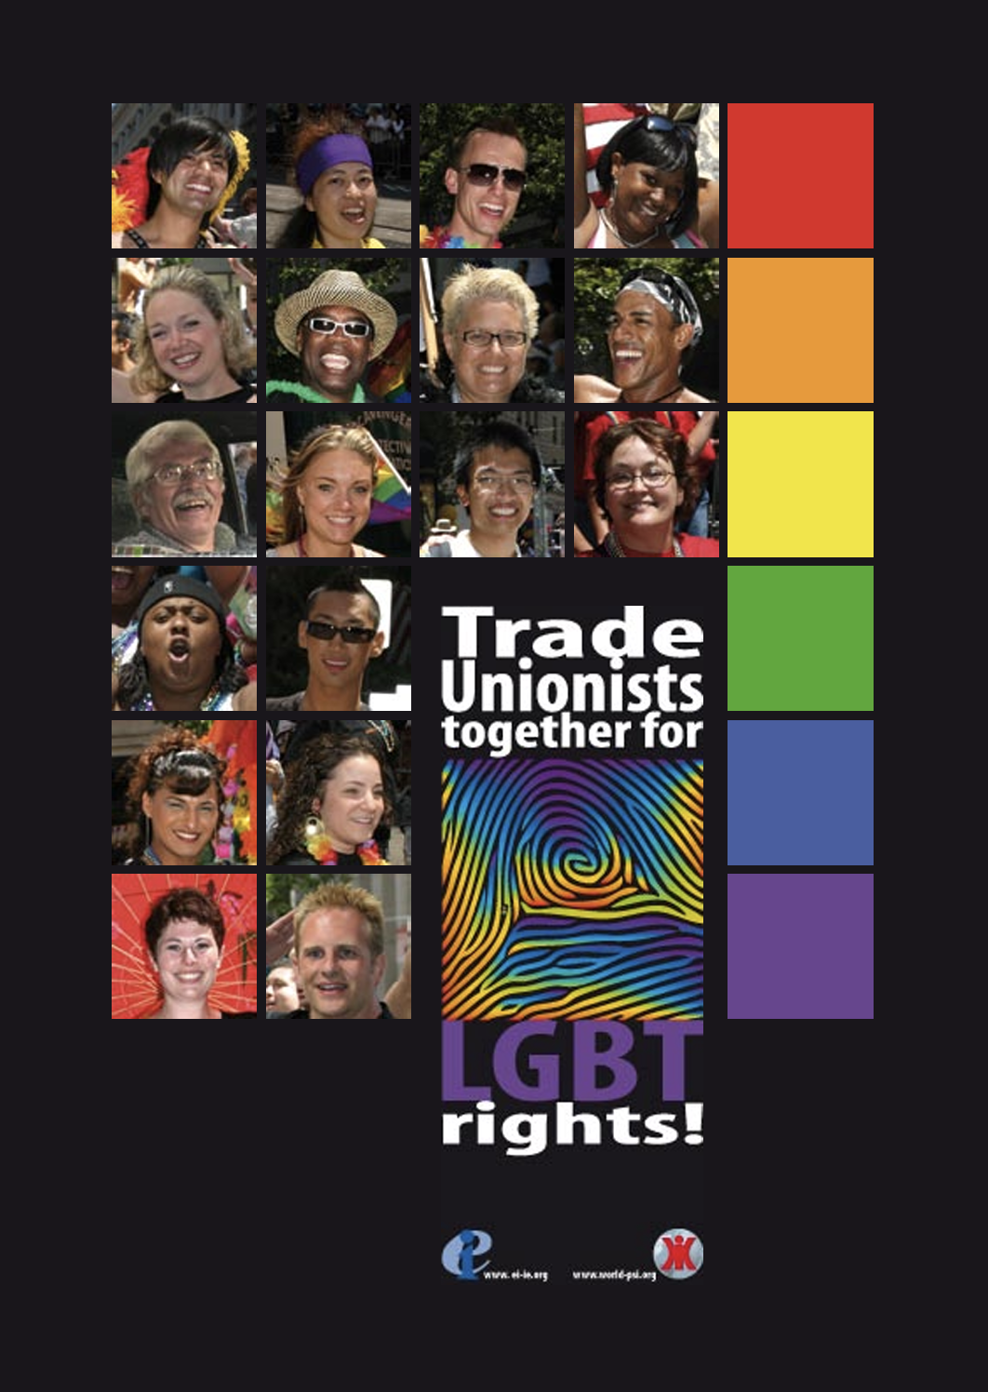
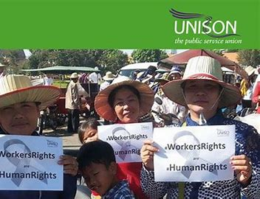

1999 – going global!
Notes:
By this time, UNISON had been affiliated to ILGA – now the International lesbian, gay, bisexual, trans and intersex association – for a number of years
UNISON was – and is - a supporting member
UNISON’s lesbian and gay group was – and now LGBT+ group is – a full member, participating in ILGA’s campaigns, meetings and democracy
UNISON was founded with a strong internationalist perspective and is members of the global union bodies for public services (PSI) and education (EI)
UNISON produced the first joint guidance on lesbian and gay workers rights for these global union bodies
This was launched at the ILGA conference in Johannesburg in 1999
Members of the then L&G committee, of the then LGBT committee and now the LGBT+ committee have been on the Ilga World and Ilga Europe Board or on the chairing pool (standing orders committees) since this time and have been instrumental in shaping the governance procedures and strategic direction of the movement.
UNISON produced an updated version for EI and PSI on LGBT workers rights in 2007
Launch of EI/PSI guidelines
Working for lesbian and gay members
We have also worked with colleagues in a number of sister unions, supporting their developing LGBT groups, including Poland, Portugal, Slovenia and South Africa

Slide 9
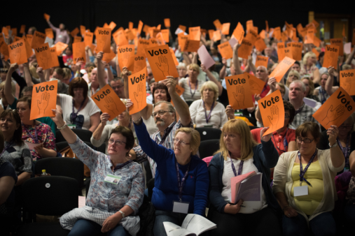
2004/2005 – becoming an LGBT group
Notes:
There was increasing discussion about the remit of the group as lesbian and gay – whether to stay lesbian and gay, become a lesbian, gay and bisexual group, or a lesbian, gay, bisexual and transgender group.
Some trans lesbian/gay members who were involved with the group had a big influence, including the first out trans member of the national committee, Eleanor Levy. Eleanor was on the committee representing disabled lesbian and gay members.
There was a period of discussion and reflection within the group, leading to a resoundingly positive vote at lesbian and gay conference on a proposal from the national lesbian and gay committee.
It was agreed to submit a rule change to national delegate conference which replaced the lesbian and gay group with a lesbian, gay, bisexual and transgender group.
Rule changes need a two thirds majority of votes to pass and the lesbian and gay group had underestimated the need to explain to the rest of the union why it wanted this change. Although it won a simple majority of votes in favour, it did not make the two thirds majority.
This was a moment of crushing disappointment followed by serious reflection and determination to do better next year.

Slide 10
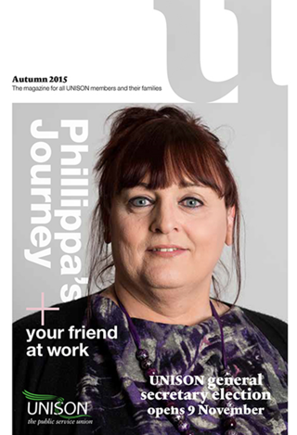
LGBT – stronger together
Notes:
The lesbian and gay group re-submitted the rule amendment to 2005 national delegate conference
But this time they asked the NEC, regional councils, other self-organised groups and branches to also submit it
It was a very moving debate and a resounding vote for change.
For Phillippa Scrafton, pictured here, it was hugely significant.
She said ‘For me, its impact has resonated for a decade. It allowed me to find my voice to challenge transphobia and biphobia in the workplace and to develop as an equalities campaigner and as a person.
I credit my career in Darlington Borough Council to the support I received from members of UNISON’s LGBT self-organised group and staff during my transition.
The impact of the decision is the reason I’m here today!’.
Phillippa went on to become the national LGBT committee’s first out trans chairperson.
In 2013, Phillippa Scrafton was elected as the national LGBT committee’s first out trans chairperson (two years later, she was the cover star of U magazine, which went out to every one of the union’s then 1.3 million members) and Maureen Le Marinel became the union’s first out gay president.
UNISON has taken a number of actions to encourage LGBT members to become shop stewards or branch officers. These include piloting a branch LGBT officer training course piloted in 2013 attended by over 30 activists, and run again at national level in LGBT History Month in 2014 and has been rolled out to the regions.
Around 300 LGBT branch officers have been through the training.

Slide 11
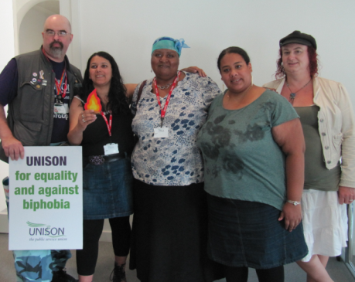
2013
Notes:
We’ve worked hard to make sure that change was not just the addition of two letters to our name.
Bi and trans members are centrally involved in all parts of our work and bi and trans equality issues are part of all our negotiating, campaigning and organising.
Bi and trans members continue to meet as national networks and are well represented on the national committee.
UNISON was proud to receive the BiCon award for Bi inclusion in 2013 – the flame held by Sarah Shahid, second on the left in this photo.
UNISON’s 2014 LGBT conference charged the national LGBT committee with moving forward on introducing fields for sexual orientation and gender identity/gender history on UNISON’s membership database, the RMS, ensuring the security of sensitive personal information.

Slide 12
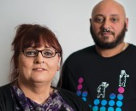
2015
UNISON’s self-organised groups exist to fight for equality and to support workers experiencing prejudice – in work and out.
Notes:
The lesbian and gay self-organised group had agreed the previous year that it should be replaced by an LGBT group, but this needed a rule change at NDC.
UNISON’s LGBT group works to improve the workplace experience of members transitioning by collecting best-practice examples of how managers can support transitioning employees.
They pass this, together with legal information and practical advice, to LGBT and equality reps and stewards across the country.
Radical proposals from first UK parliamentary trans equality inquiry During the autumn of 2015, the House of Commons Women and Equalities Committee carried out an inquiry into transgender equality. UNISON, the TUC and most trans organisations submitted evidence, as did many individual trans people. Its report, published on 14 January 2016, was remarkable in its recommendations and contains much that UNISON welcomes. You can read it on the committee website at parliament.uk/womenandequalities.

Slide 13
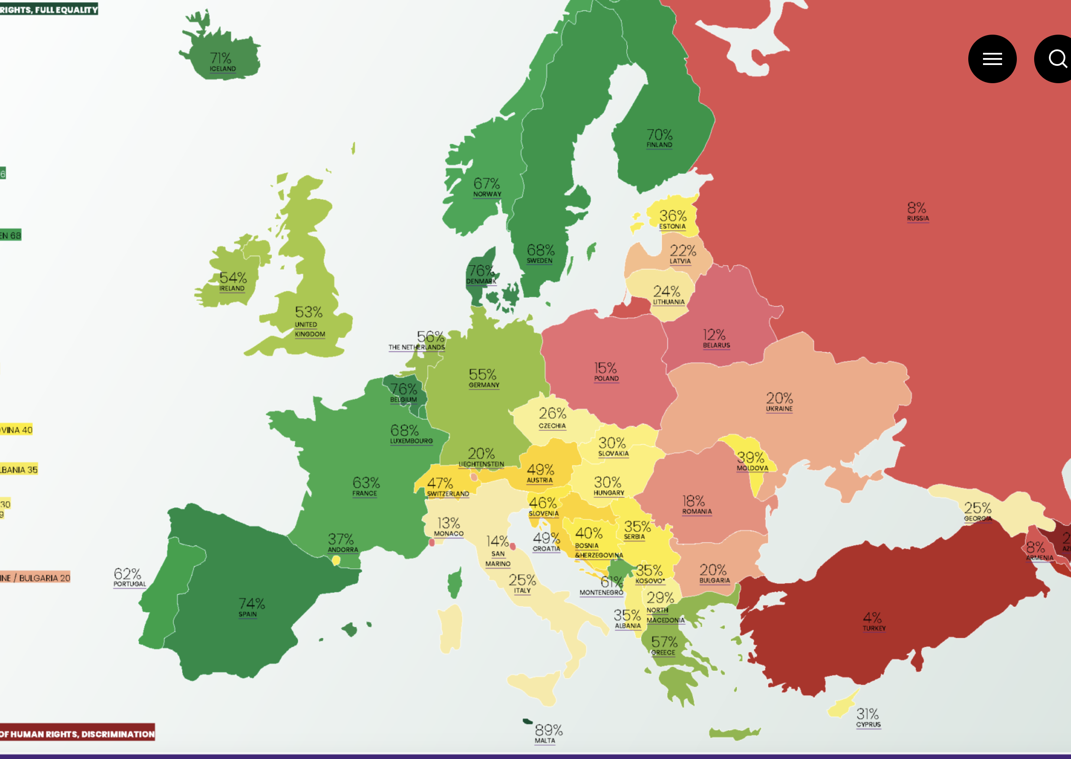
The Rainbow Map ranks all 49 European countries on a scale between zero and 100 percent. Zero percent means gross violations of human rights and discrimination — while 100 percent entails full respect for human rights and full equality.
Notes:
For a number of years, the UK topped ILGA-Europe’s annual index of European countries. Not in 2016. Now Malta proudly leads the way, with Belgium following and the UK trailing more than 6 points behind. The index ranks the 49 European countries based on how the laws and policies of each country impact on the lives of LGBTI people. It’s not that UK laws and policies have worsened. It’s that other countries have moved ahead. When the 2004 Gender Recognition Act was passed, it was groundbreaking. You only needed a diagnosis of gender dysphoria (amongst other requirements). You did not need surgery or other medical treatment. But now in Malta, Ireland, Argentina, Denmark and Colombia, legal gender recognition has been completely depathologised – taken out of the hands of the medical profession. It is now a process of self-declaration, making the UK model look outdated, bureaucratic and undignified.
The 2016 ILGA maps were out of date straight away Every year for IDAHoBiT, ILGA produces world maps showing where sexual orientation is criminalised and where it is protected. ILGA is an LGBTI organisation, but the world maps only show laws on sexual orientation. To produce a map on LGB AND trans laws would be impossibly complex (never mind trying to include intersex issues), because the picture is often very different. For example, Belgium is second best in Europe on LGB rights but way down the index of trans rights produced by Transgender Europe. This year, the very day the world maps showing where homosexuality is criminalised were published, the parliament in the Seychelles voted for decriminalisation. That’s the sort of out of date we like! The global ILGA LGB maps are at ilga.org More detailed info on Europe is at rainbow-europe.org Map and index of trans rights at tgeu.org

Slide 14
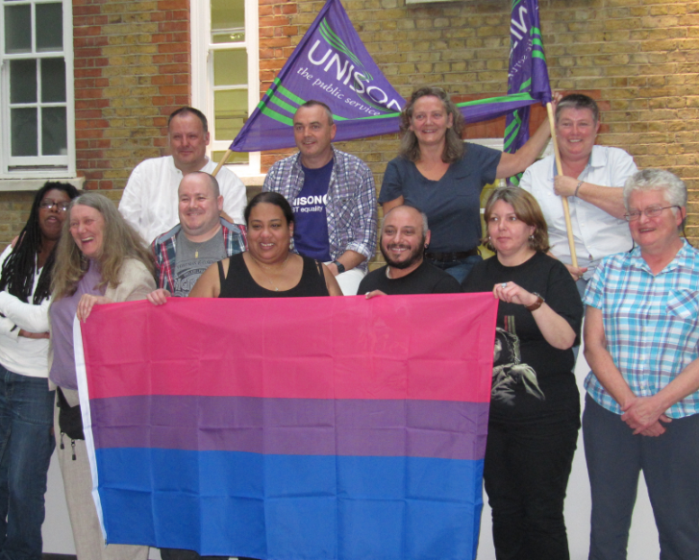
2016
Our vision for LGBT equality
As social attitudes are changing, some people think the fight for lesbian, gay, bisexual and transgender (LGBT) equality is over.
Notes:
Launch of the ‘Our vision for LGBT Equality’ factsheet

Slide 15
2017 / 2018 the long journey to include the plus
2017 – Young members submitted a motion to the LGBT conference, which was overwhelmingly carried
2018 – LGBT committee consulted on becoming a LGBT+ group
Notes:
In 2017, UNISON’s young members forum submitted a motion to LGBT conference highlighting that many people, particularly young people, identify their sexual orientation and gender identity in many different ways beyond a binary definition.
Young members acknowledged that the LGBT group used umbrella definitions of Bi and Trans, but that many people did not know this, and felt that the LGBT group did not include them.
Young members expressed a preference to see the LGBT SOG move to organise on an LGBT+ basis, demonstrating an inclusiveness beyond that defined by its current name.
As instructed in the motion, the national LGBT committee consulted on adding the plus in the early part of 2018. Regional and branch LGBT groups and individual members were encouraged to respond to the consultation.
78% of respondents agreed it was time to add the plus (against 17% who didn’t want any change)
Comments received included:
A welcome move to bring us up to date
I like the proposed new name, I feel it does bring more inclusiveness to people
Its time for this change so that we are truly reflective of our membership and our potential members
By changing to LGBT+, we are sending a strong signal to show we are completely inclusive. More and more people are self-defining under the + group these days
It's more inclusive than the current name. I identify as Trans, Bi, Queer, Questioning, & recognise that the + covers these too

Slide 16
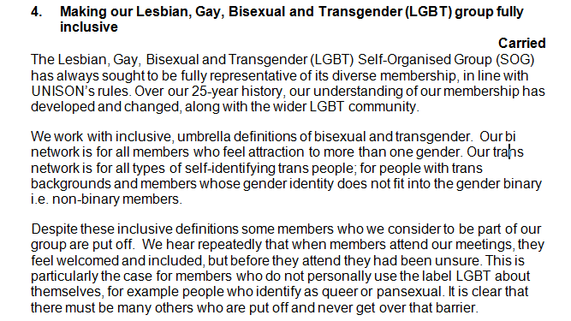
2018 – LGBT conference
Conference passes a motion to become more inclusive
And agrees a motion and a rule amendment to 2019 National Delegate Conference

Slide 17
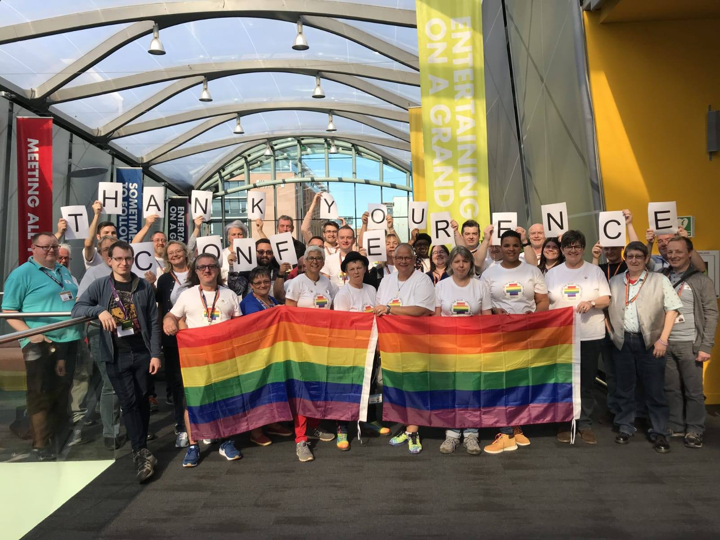
2019 – National Delegate Conference
Rule amendment and policy motion to become a LGBT+ group carried unanimously
Notes:
In the lead up to conference the national committee:
Produced and presented in as many forums as possible a presentation explaining why we wanted to add the plus
Produced and circulated a fact sheet explaining why we wanted to add the plus
Drafted and submitted motions to branch meetings asking branches to request that their regions prioritised the LGBT rule amendment and to mandate their delegates to vote for rule amendment
Drafted and submitted motions to regional councils / committees requesting that the LGBT rule amendment was prioritised
Produced stickers, badges, fliers and t-shirts for national delegate conference
We are very proud to say that we don’t think there was a delegate, visitor or NEC member at NDC who didn’t know how much we wanted that plus
And yes, there were tears of happiness, relief and joy once both the motion and the rule amendment were carried unanimously. Oh and a few sore heads the next morning from celebrations that went on late in the night!

Slide 18
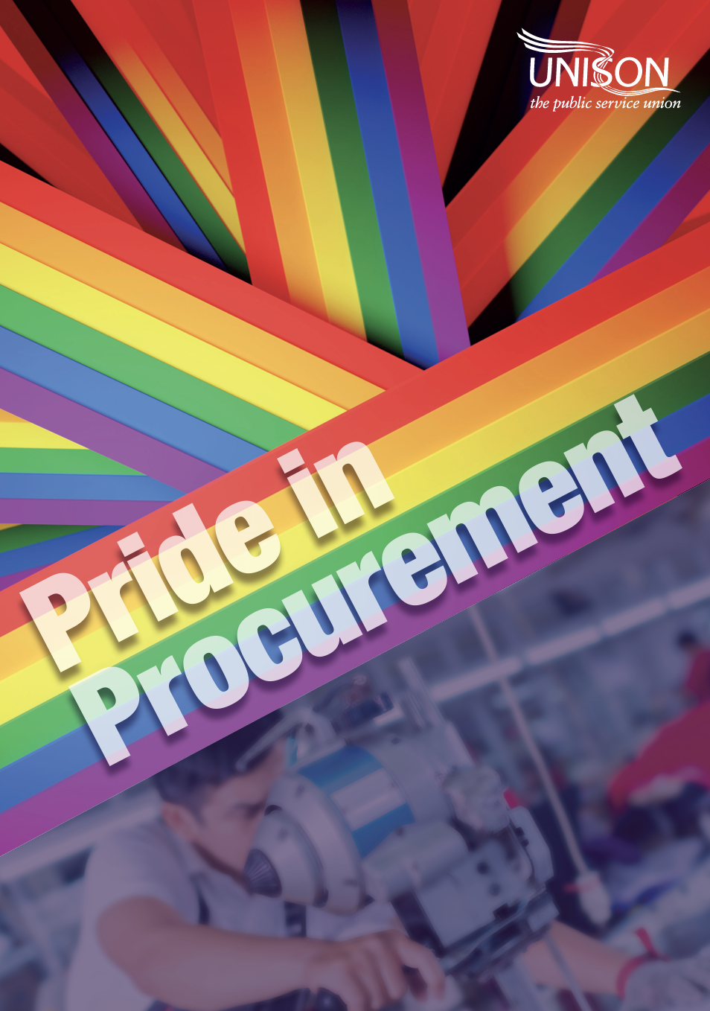
Pride in Procurement
Global inequalities are baked into the garment industry. Big brands and retailers make obscene profits at the top of supply chains, whilst workers are paid poverty wages.
Notes:
Power & privilege in Pride movements Globally, the LGBT+ rights movement is seen to prioritise issues that mainly affect white Western populations. For instance, high profile campaigns for same-sex marriage have galvanised more mainstream support than protests against violence inflicted on trans women of colour. When we look at our own power and privilege it helps us to better understand global workers’ right
UNISON has worked with Labour Behind the Label to help activists planning Pride events become even more informed and discerning buyers, so that we can promote pride in procurement, as well as in our workplaces, in our communities and around the world

Slide 19
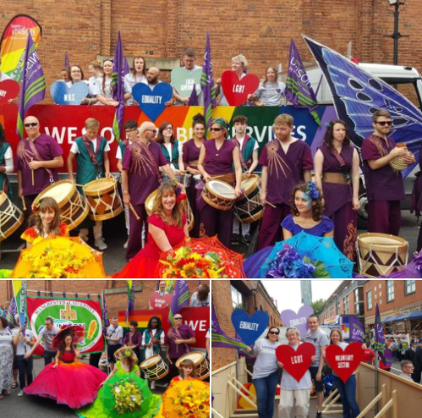
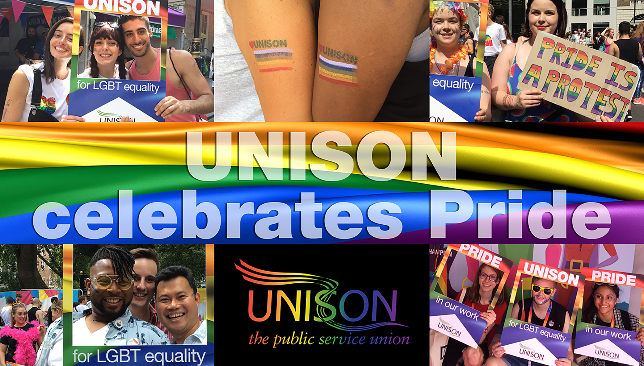
2020/21 – The Covid Years!
UNISON held its first
virtual Pride on Facebook
Notes:
During 2020 the national LGBT+ committee pushed ahead with as much of its work programme as possible and continued to meet online.
In July we organised our first virtual Pride is still a Protest event with contributions and photographs from previous Prides supplied by regional UNISON LGBT+ groups across the UK, and showcasing the numerous resources UNISON has produced to support branches and members.
The event can still be viewed here:
https://www.facebook.com/events/223365612076612/?active_tab=discussion

Slide 20
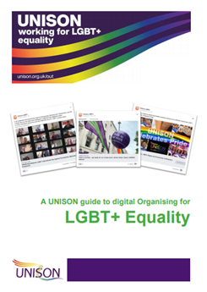

We produced our first Digital Organising Guide
And hosted our first ever
Notes:
In July and September network webinars were held for Bi+, Trans, Disabled LGBT+ and Black LGBT+ members in place of the usual annual meetings.
The national LGBT+ committee produced new resources for members which are available on the national website LGBT+ members page, including a brand new Digital Organising Guide: https://www.unison.org.uk/content/uploads/2020/11/Digital-Organising-for-LGBT-Equality-Guide-2020-FINAL.pdf
In November, in place of the annual LGBT+ conference, a series of webinars and online workshops were held for members – LGBT+ Live! which were well attended and covered a broad range of topics:
UNISON campaigns – No Going Back to Normal!
The Effect of C19 on LGBT+ People
Digital Organising for LGBT+ Equality
Hotspots and Not Spots for LGBT+ travel in Europe
Trans Ally workshop
Pride in Procurement (ethical procurement)
And included a closing plenary session and online social activities.

Slide 21

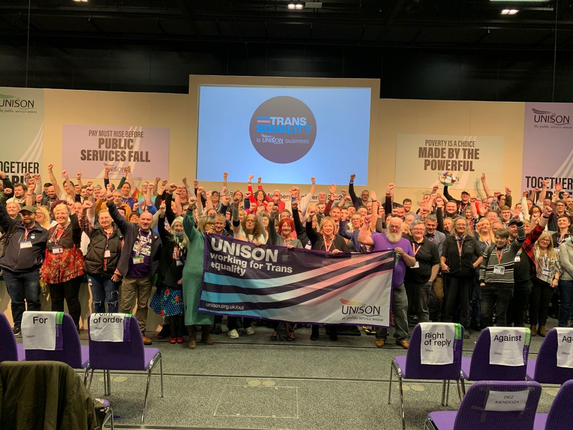
2022
We launched our Trans Equality campaign
Notes:
The Trans Equality Campaign was launched in July 2022.
As part of this campaign, we launched the trans ally campaign. As of Jan 2024, we have trained over 3000 UNISON members on how to be a trans ally at work. We have also grown the trans, non-binary and gender diverse network to over 450 members across the UK and we are seeing more activism across UNISON.

Slide 22
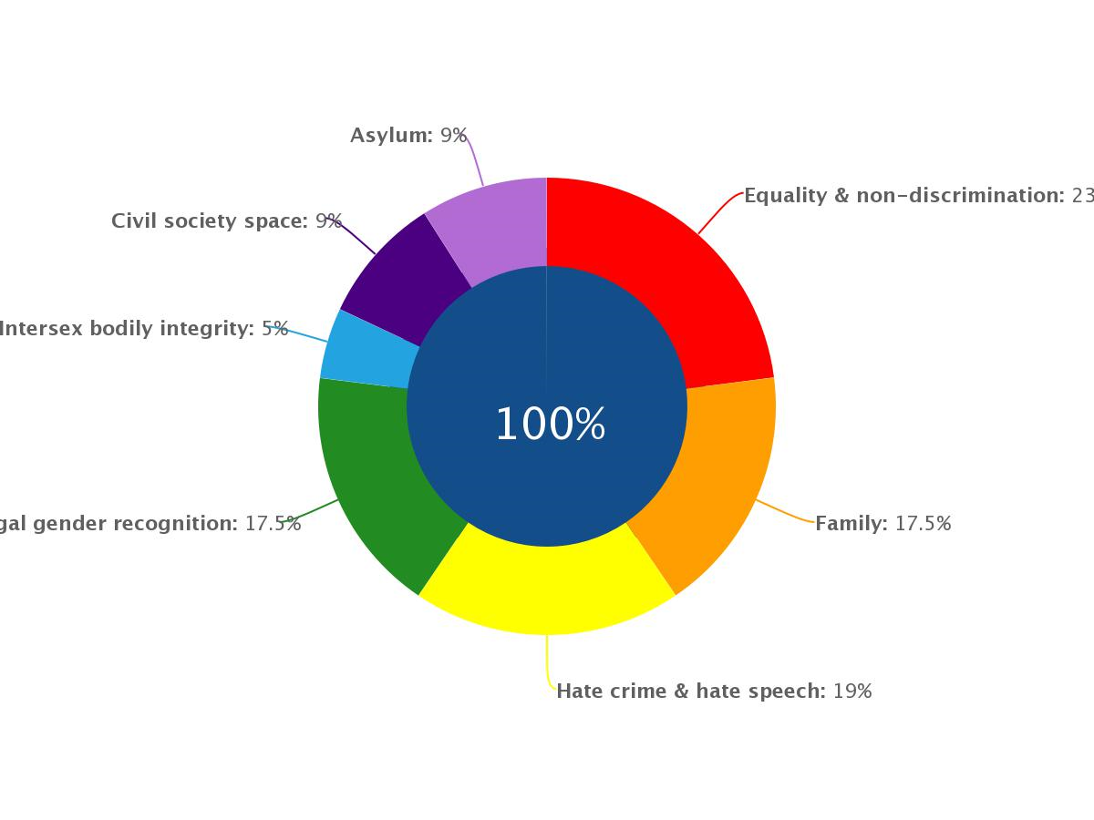

2023
The UK’s ranking on ILGA Europe’s rainbow map plummeted to 17th position
Notes:
ILGA Europe covers the geographical region of Europe and Central Asia. IE works for LGBTI people's safety, equality and freedom. In collaboration with and on behalf of over 700 LGBTI member organisations across Europe and Central Asia.
Rainbow Europe brings together both the legal index of LGBTI equality based on IE’s Rainbow Europe Map and an overview of the social climate for LGBTI people in each country based on the Annual Review of the Human Rights Situation of Lesbian, Gay, Bisexual, Trans and Intersex People.
Despite intense anti-LGBTI attacks in several countries, equality is still advancing across Europe.
While the public discourse is becoming more polarised and violent, particularly against trans people, political determination to advance LGBTI rights is paying off. The largest gains on the map are for countries that introduced legal gender recognition using a self-determination model. Over the past 12 months bans on intersex genital mutilation (IGM) are also bringing countries up in the ranking.
Rainbow Europe – ILGA-Europe’s annual benchmarking tool – comprises the Rainbow Map and Index and national recommendations. ILGA-Europe have produced the Rainbow Map and Index since 2009, using it to illustrate the legal and policy situation of LGBTI people in Europe.
The Rainbow Map and Index ranks 49 European countries on their respective legal and policy practices for LGBTI people, from 0-100%.
The UK has slipped in 2023 to 17th among 49 europaen countries 😥

Slide 23
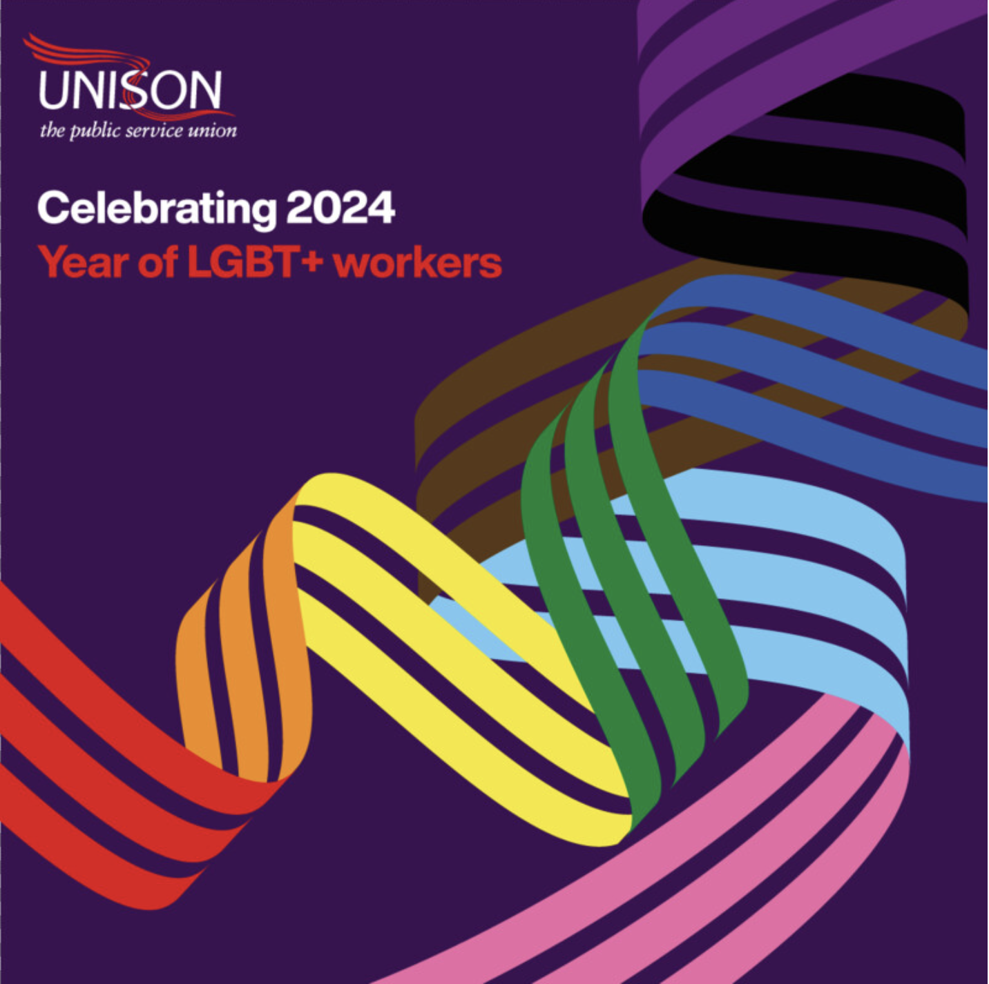
And now it’s 2024 – The year to celebrate our LGBT+ members
Notes:
Following on the successful UNISON years of the disabled worker and the Black worker it it now our turn to highlight and champion our lives during the year of the LGBT+ worker.
We have the resources to back our campaigns. Contact you branch or your region and specifically ask for the LGBT+ bargaining and campaigning materials.
Our story is still very much alive.
There is still much to be done for LGBT+ equality
We look forward to the telling of the next chapter …

Slide 24
unison.org.uk/out
out@unison.co.uk
Mitchell Coe
national officer LGBT+ equality
m.coe@unison.co.uk

