Slide 1
UNISON Social Work Webinar
UNISON/Social Work England: Safe and effective practise
and fitness to practise referrals
Sep 23, 2021

Slide 2
Responding to a fitness to practise referral and making a self-referral Jonathan Dillon Executive Director, Fitness to Practise Berry Rose Head of Fitness to Practise Investigations Rachel McAssey Head of Registration
Notes:
PG

Slide 3
Welcome…
To set out Social Work England’s approach to fitness to practise and registration
To give an overview of the fitness to practise and registration processes
To explain what happens when we open a fitness to practise investigation
To give an overview of safe and effective practise, what you need to tell us and when
Purpose of the session
Notes:
Jon’s slide

Slide 4
What is fitness to practise?
‘When we say that someone is ‘fit to practise’ we mean that they have the skills, knowledge, character and health to practise their profession safely and effectively without restriction.
‘Fitness to practise is not just about professional performance. It also includes acts by a social worker which may damage public confidence in the profession. This may include conduct that takes place outside of the workplace, such as acts resulting in criminal investigations.’
A Guide to Fitness to Practise Social Work England (2020), p.4
Notes:
Jon’s slide
Fitness to practise is about protecting the public and the wider public interest in social work now and in the future.
No about apportioning blame,. Looks at present and the future.
There is no agreed legal definition, but it is generally understood to mean the current suitability of the social worker to hold registration and practise without restriction.
Fitness to practise involves assessing the position today and going forward. This position may be different from what it was when the event or events occurred.
When we say that someone is ‘fit to practise’ we mean that they have the skills, knowledge, character, and health to practise social work safely and effectively without restriction.
Fitness to practise is not just about professional performance. It also includes acts by a social worker which may damage public confidence in the profession.
This may include conduct that takes place outside of the workplace, such as acts resulting in criminal investigations.
If we decide that a social worker’s fitness to practise is impaired, it means that we have identified serious concerns about the suitability of their character or their ability to practise safely and effectively.
This may mean that we must restrict a social worker’s practice or, in particularly serious cases, issue an order which removes a social worker’s ability practise immediately.

Slide 5
Our approach
An approach that aligns good regulatory practice with good social work practice.
That means:
Robust triage of concerns
Social work expertise at all major decision points
Impartial & enquiry led investigations
More options to conclude cases without a hearing
Flexible approach / Transitional caseload
Collaborative working
Notes:
Jon’s slide
Modern approach to regulation – statutory scheme reflects. Inquisitorial not adversarial approach. Accepted disposal. Professional advice.
Difference between transfer and new caseload
Collaborative approach – reflected in our transparent process and the way we have worked with the sector to develop guidance (e.g. Employer guidance on FTP and self referral guidance)

Slide 6
Setting the scene
Most concerns are raised by members of the public 73%, followed by employers 15% , 6% self referrals
Concerns raised to us have included themes of :-
poor or inappropriate communication 26%
dishonesty 23%
safeguarding concerns 16%
Children and family's social workers 81%
Social workers working in court settings 10%
50% concluded at triage stage
Notes:
Berry’s slide
Since becoming the regulator, we have received more concerns than expected. Case forecasts based on referral rates at the previous regulator suggested that the triage team could expect to receive around 120 referrals per month. Since January 2020, the average monthly rate of new concerns has been 156 and appears to be increasing.
Responsive and thorough assessment of concerns received. Around 40% concluded at triage. Important – lots of the concerns we received are about social workers doing good social work – it’s essential that we can identify these referrals at the earliest possible stage
Triage decision making is supported by professional advisors (both registered social workers) and members of our legal team

Slide 7
Fitness to Practise – overview
Social Work England will deal with concerns using the principles of fairness, proportionality and timeliness and aim to engage with the social worker throughout the process.
Social Work England’s overarching objective is the protection of the public. This includes objectives:
to protect, promote and maintain the health, safety and wellbeing of the public
to promote and maintain public confidence in social workers in England
to promote and maintain proper professional standards for social workers in England.
Notes:
Berry’s slide
We know that fitness to practise cases can take an emotional toll on everyone involved.
But if the process of managing concerns starts well locally, our process – should we need to get involved – can happen more quickly and we can make better decisions.
We know that social workers work hard every day and the majority are committed to doing their best for people who use their services. However, on rare occasions, there may be concerns about whether someone is fit to practise, and their employer will need to take action to respond to those concerns.
Social Work England will deal with concerns using the principles of fairness, proportionality and timeliness and will engage with you as the employer throughout the process.
Decisions will be taken with reference to the seriousness of the concerns.
Where local action, i.e., by employers, cannot manage any potential risk to people who use services, we may need to take action to protect public confidence in the profession and to uphold Social Work England’s professional standards

Slide 8
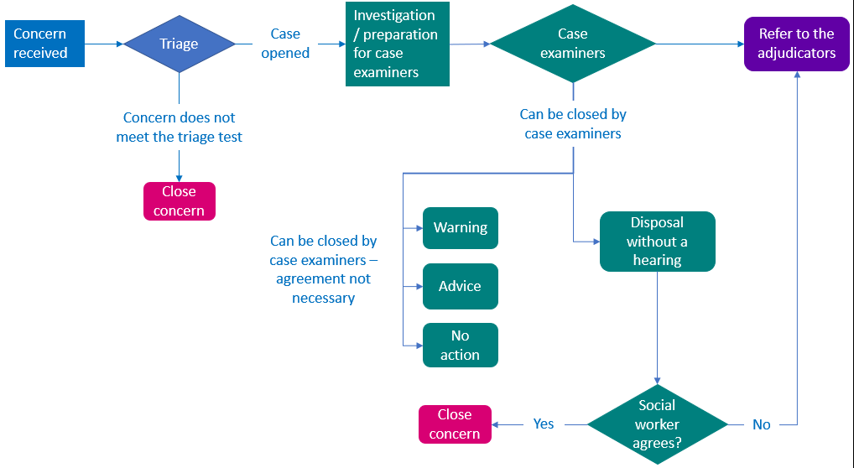
Fitness to practise process
Notes:
Berry’s slide
Overview of FtP process
Triage – around 50% of cases concluded at this stage
All cases assigned to two investigators – 1 lead and 1 investigator
Legal and professional advice available at all stages
Case examiner disposal – around 70% of cases concluded at this stage

Slide 9
When we open an investigation
Notify the social worker within 7 calendar days
Sharing information
Inviting the social worker’s response
Making adjustments
Notes:
MD
Notify the social worker of exactly what concerns we are investigating, who raised the concerns and our reasons for opening a FTP case
Recognise the importance of tone and content of notification letter – developed with insights from our team of RELs then reviewed and refined following feedback from Unison
We will sometime have narrowed down the concerns at the triage stage – will explain this
Will ask you to provide your past and present employment details - this is a statutory requirement. The social worker needs to respond within 7 calendar days
Will list the information we have received and offer to share if you want it
Invite you to make a response at the outset – set out importance of this and fast tracking process, use the structured response template – helps us to understand what action may have already been taken at a local level, contextual factors, remediation etc
Let us know of you need us to make adjustments – e.g. preferred method of communication, other communication needs etc
Investigations are private and we don’t publish information about investigations. We will disclose that we are investigating concerns to your current employer – limit disclosure to what is necessary. May also make enquiries with previous employers

Slide 10
Registration: safe and effective practice
As the regulator in order to protect the public we need to be satisfied that you have the relevant:
skills
knowledge
character, and
health
Regulation 11(2)b The Social Workers Regulations (2018): In the case of a registration under regulation 10, a person is eligible to be registered where the regulator is satisfied that they are capable of safe and effective practice in accordance with the professional standards relating to proficiency, performance, and conduct and ethics.
Notes:
Rachel’s slides

Slide 11
You will be asked to declare any health conditions that might affect your ability to carry out your usual duties as a social worker
Any criminal convictions, cautions or penalty notices (unless for speeding). Including any convictions from overseas which, if committed in England and Wales, would constitute a criminal offence
You should also declare any fitness to practise investigations or if you’ve been barred from working with vulnerable people.
If you are in a situation where you will need to make a declaration, read our public guidance or contact us and we can advise you on the sorts of documentation we will ask you to provide. At renewal or restoration you only need to tell us about new occurrences, you do not need to declare everything each time.
Making a declaration
Notes:
Rachel’s slides

Slide 12
Considering a declaration
We may ask for further information in order to make an assessment, this is explained in our detailed guidance.
Outcomes: Accept, Refuse, Conditional Registration
And with applications to renew, declarations that meet the triage criteria can also be referred into fitness to practise.

Slide 14
Kelly Hannah-Rogers
National Officer
UNISON PSU
UNISON PROFESSIONAL SERVICES UNIT Referral and Self Referral to Social Work England

Slide 15
WHO ARE UNISON PSU?
You may be entitled to be advised and represented by UNISON’s Professional Services Unit (PSU) if:
• You face allegations that your fitness to practise is impaired OR
• You have applied for registration or renewal of your registration with Social Work England, but your application has been refused.
~ your trade union structure
~ how to make contact

Slide 16
What to do if a concern is raised?
REMEMBER Anyone can make an allegation that your fitness to practise is impaired and refer the allegation to your professional regulatory body SWE at any time. Do not delay! Inform your UNISON branch right away!
Public
Employer
Colleague
Another regulatory body

Slide 17
What should you do if your professional regulatory body SWE sends you a letter asking you to respond to allegations about your fitness to practise?
immediately ask your UNISON branch to seek help from UNISON’s Regional Office who will obtain advice and representation from UNISON’s PSU to assist you with your response. Do not reply to your regulatory body without obtaining advice from your UNISON branch.
If your case has already been referred to UNISON’s PSU and you receive correspondence from your professional regulatory body asking you for a response, or to complete any forms about their allegations, you must contact PSU at once for advice. Do not reply to your regulatory body directly, seek advice from PSU.

Slide 18
If you receive a letter from your professional regulatory body SWE informing you of a hearing including an Interim Order Hearing?
Contact your UNISON branch immediately to ask the UNISON Region to send your case to UNISON’s PSU for advice and representation do not ignore it! If you have been told that your case has already been sent to UNISON’s PSU, contact PSU directly for advice and representation.

Slide 19
What to do when considering self-referral?
Discuss with UNISON first
Case Sensitive
Just because you may have a health condition, or are subject to an employment process, does not mean your fitness to practise is impaired.

Slide 20
What to expect
YOUR UNISON PSU REPRESENTATIVE WILL:
Analyse and assess the available evidence provided by SWE and advise you whether the evidence is likely to prove or disprove the allegations against you
Advise and discuss with you about what matters you should address in your written response to the regulatory body’s Investigation to Case Examiners.
Advise and discuss with you any consensual disposal options.

Slide 21
What to expect contd …
Advise and discuss with you what you should do when faced with full hearing should your regulatory body decide there to be a case to answer including :
a) Advising and assisting you with gathering evidence in support of your response to the allegations:
b) Advising you on which witnesses should be called to give evidence to support your case.
Advise and assist you with writing your witness statement for hearings
Represent you at all hearings of SWE process
Advise, discuss and identify with you any steps you could take should you need to improve your practice or conduct.

Slide 22
Quick word on …..
Disclosure and Barring Service (DBS)

Slide 23
Thank You
Contact Details
UNISON Direct 0800 0857 857
www.unison.org.uk

