Slide 1
Supporting learners to be at the
heart of Area Reviews
Katie Shaw, Policy & Campaigns Manager, NUS

Slide 3
This Session
What we know about area reviews
Broadly what NUS is doing
What students think
Supporting students locally to campaign

Slide 4
Why Area Reviews?
…we need strong education and training institutions which have high status and are genuine centres of expertise. On that basis, and at a time when we are asking all publicly funded institutions to consider how they can be more efficient, it is right that we review post-16 provision in every area.”
Nick Boles MP, Minister for Skills
Reviewing Post-16 education and training institutions: guidance on area reviews
Sept 2015
Notes:
The move is towards “fewer, larger, more resilient and efficient colleges”
“Increased Specialisation” of campuses.
GFE and Sixth form will be expected to take part in each area with input from local authorities, local enterprise partnerships (LEPs), local employers and others to work together .
Across a series of 5 meetings, Area review boards will meet, review curriculum and plan “rationalising” of curriculum, estate and back-office function
Colleges are invited to take part individually in the process and decisions will be made by boards in areas. It will be up to each individual governing body to accept the proposals or explain why they have declined them.

Slide 5
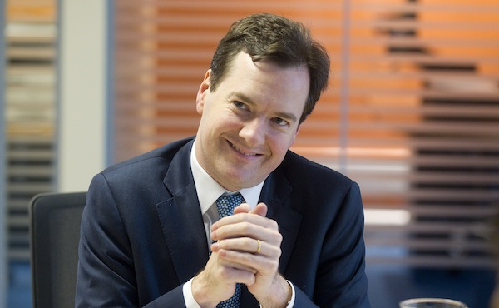
Notes:
National Audit Office in July stated that there was “rapid decline” in the financial status of 244 institutions across England.
AoC state there are 335 colleges in England. 73% are in rapid decline.
3.9% additional cut to Adult Skills Budget, announced in July, on top of 24% cut expected.
Also cuts to ESOL completely for 2015/16.
Labour announced yesterday that they believe 3 in 10 colleges will be forced to close
In essence, colleges have faced around a 40% cut to their budgets over the last 5 years, mainly to adult learning. This is despite the fact that adult learning is vital to getting people reskilled or upskilled into decent jobs and increasing the “productivity” of the country.

Slide 6
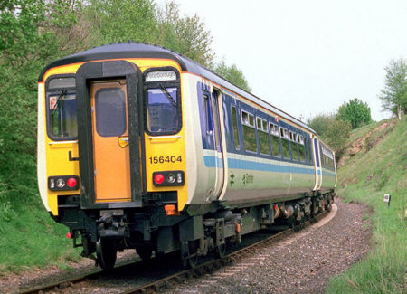
A roundtable for every area!
Ensure the recommendations of Area Based Review boards reflect the needs and views of students
Protect and strengthen learner voice in further education for the long term
Notes:
• A student led round table is delivered for every Area Review area.
• A report is produced for every student led round table and is endorsed by the majority of student representatives from each area. This feeds into ABR board decisions
• Student governors are supported to contribute to ABRs through college boards
• NUS represents the views of students at Department and Ministerial Level.
NUS engages students in the Area Review process through #FEunplugged
NUS supports SUs and student leaders to understand ABRs and to inform and engage with students about them
NUS encourages wider public discourse and lobbying through local and national press.

Slide 7
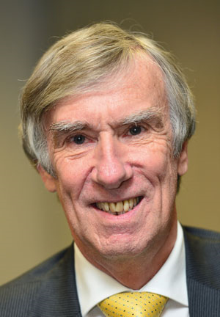
‘Welcome to the world of work….’
Sir David Collins, FE Commissioner

Slide 8
Activity…
In groups, think about what learners would answer to the below questions…
What makes high quality education?
What do learners need in order to access education?
What are the outcomes learners want from their education?
How should learner voice to function in new, larger institutions?

Slide 9
High quality education
We expect our teachers to be sufficiently qualified in both education and the industry in which they teach.
There is more to a high-quality education than typical success measures. We believe providers and the sector should focus on developing the “whole person”.
We expect that class sizes are not so big that they affect the quality of our education.
Online and digital learning should be part of our education, but it needs to clearly improve teaching and learning and not be used as a cheap alternative to teachers.
Understanding equality and diversity is really important to our learning. We expect this to be embedded in our curriculum so all learners have a clear understanding and respect for the diversity of the college and the community.
Feedback is key to helping us understand and progress in our learning.

Slide 10
Accessing Education
We expect to be physically and financially able to travel to and from our education, with support available to learners who need it.
Support with living costs for those who need it should be in place to allow all potential learners to access their education, regardless of their background.
Our timetable should be efficient and enable us to get the most out of our time in college.
People need high-quality information, advice and guidance to better understand the options available to them and to increase the profile and status of FE across the Sheffield area.
Student support services in colleges, whether for students with learning difficulties, international students or those facing other barriers, are key to helping us achieve.
Learners’ choices and ambitions should come ahead of the wishes and needs of employers.

Slide 11
Outcomes
Learners want their education to give them confidence in who they are and develop a clear sense of identity.
We should be able to define what we see as positive outcomes ourselves, rather than assumptions being made about what is a positive outcome for us.
Learners want to do the right course to help them build a career, not just to get a job.
Progress is personal, leading to personal ideas of positive outcomes. Measures based on outcomes should take this into account.
Students think that Area Reviews provide an opportunity to deliver more subjects blending academic and vocational learning.
Positive outcomes for learners include practical study and life skills that help us be active citizens

Slide 12
Learner Voice
There needs to be a learner-led, professionally supported students’ union infrastructure to represent students in each institution.
We believe providers and funders should commit to support learner-led voice, both strategically and financially.
There should be a greater focus on inclusion of the diversity of learners in the area into learner voice activity, including apprentices.
Feedback is good, but learners should also be partners in finding the solutions to problems, thereby closing the feedback loop.
We expect learners to play a key role in the regional decisions that affect them.
There should be spaces for learners who self-define into different liberation groups to meet, feel safe and raise issues with the support of their peers.

Slide 13
Dr Franken-Boles

Slide 14
#FEunplugged

Slide 15
#FEunplugged
Aims
To make sure learner voice is heard and students needs met throughout the AR process
To raise the profile of AR’s to make national press/public care about what's going on and local communities empowers to become vocal in the process
To hold Ministers to account over poor decision making

Slide 16
Actions
To get students and members of the community to lobby their MP via our ‘take action’ on www.nus.org.uk/feunplugged
SU’s to run activities to get information on what’s important to students in their education (class sizes, transport, disability support etc).
SU’s then use that information to lobby and campaign to a range of decision makers.

Slide 17
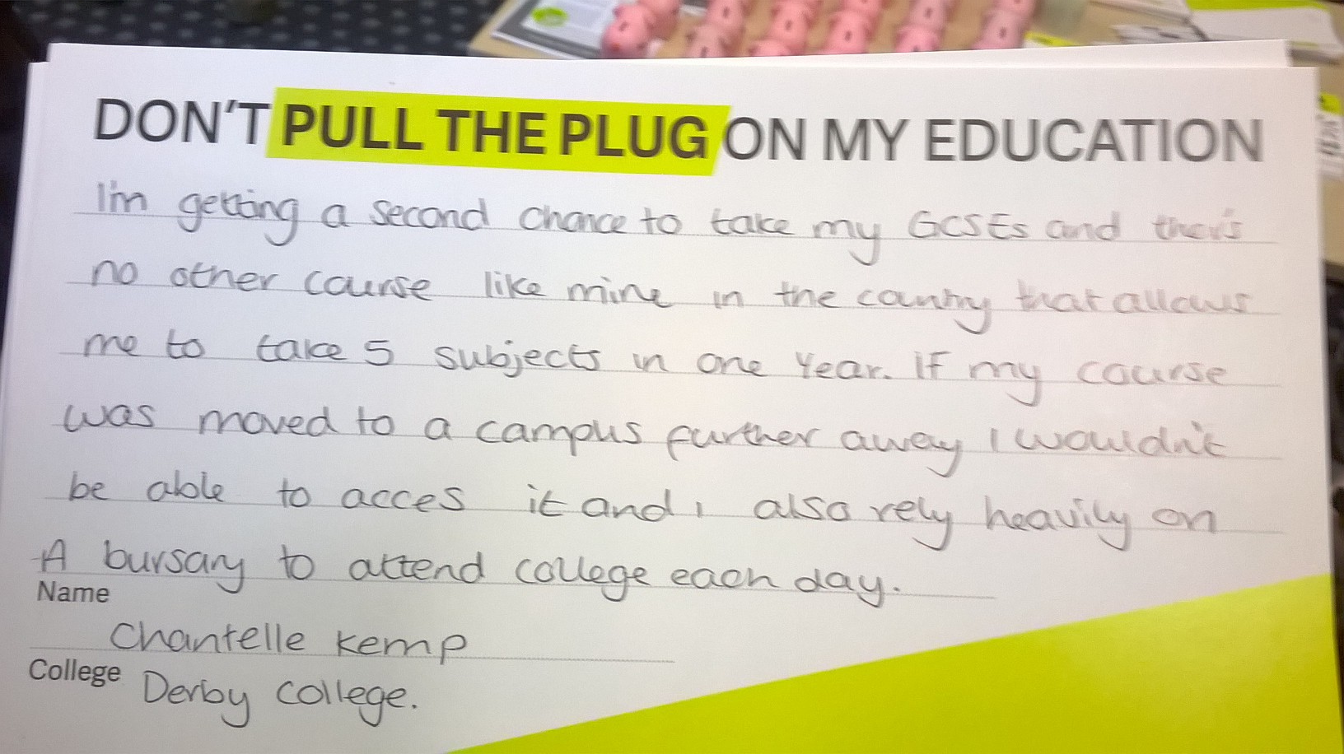
Derby College

Slide 18
Dudley College

Slide 19
Wiltshire College

Slide 20
In Groups…
What’s your branch’s relationship like with your colleges union? (do you have one?)
Where might you have similar/related concerns about Area Reviews to you students?
What activities can do you collectively to make sure both learner and staff voice is heard at college, local, regional and national level?

Slide 21
#FEunplugged
For more information about the campaign, contact katie.shaw@nus.org.uk
To order a campaigns pack, contact holly.Staynor@nus.org.uk
www.nus.org.uk
www.nusconnect.org.uk

